Slide 1
Google Apps
for libraries!
Samantha Bremekamp

Slide 2
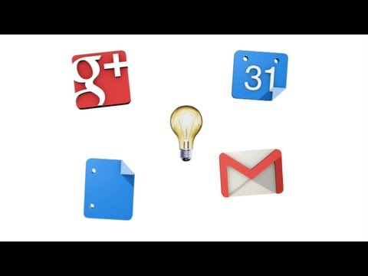
What are Google Apps?

Slide 3
The Cloud
Using Google Apps allows you access to your work anywhere internet is accessible.

Slide 4
Google Apps in Libraries
http://www.thedigitalshift.com/2011/12/information-technology/libraries-chromebooks-and-google-apps/
http://www.slideshare.net/jezmynne/updated-google-apps-for-libraries
http://pplfriends.org/content/google-apps-account-fppl-members

Slide 5
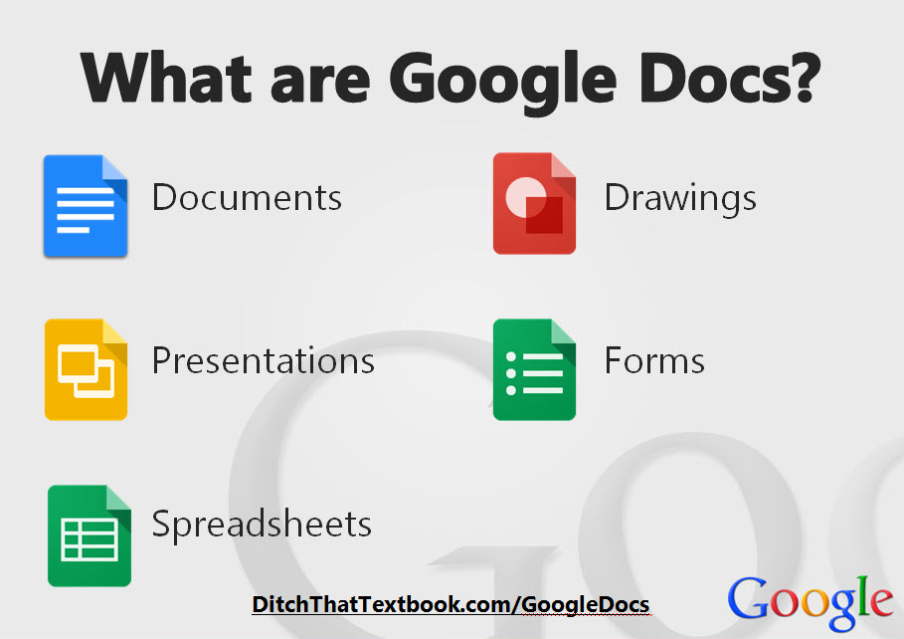
Stop! Collaborate and Listen: Shared Documents
Spreadsheets
Word Docs
Presentations
Forms
Drawings

Slide 6
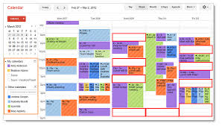
Google Calendar
Sharing is caring.

Slide 7
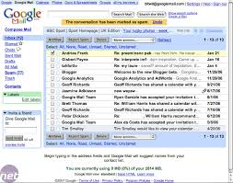
Google Email: Gmail
User friendly and easy!

Slide 8
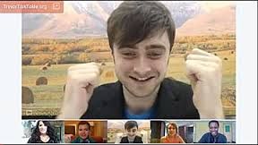
Google Hangout: Meetings anyone?
This is the best way to collaborate on projects with those not in the same building as you, from all over the world.

Slide 9
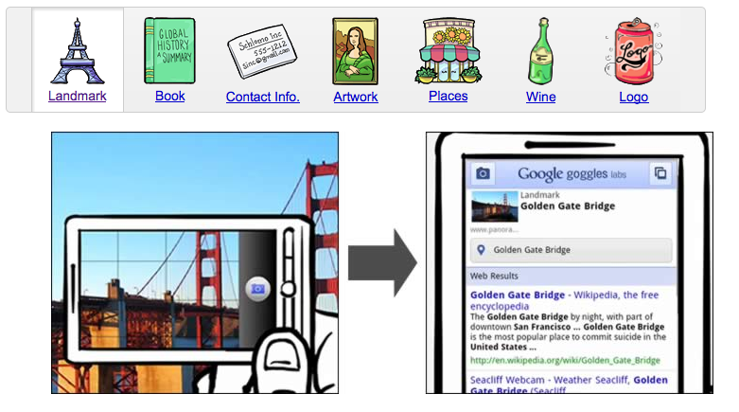
Google Goggles: A librarian’s best friend.
Google Goggles
allows anyone, like a
librarian or a patron to
snap a photo of anything
and help label it
and pull up info on it!!!

Slide 10
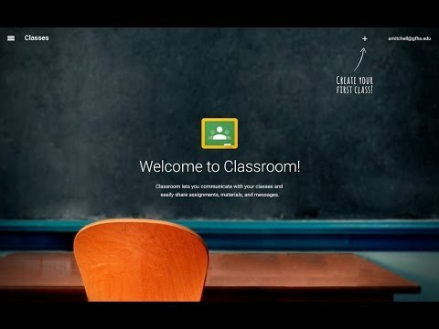
Google Classroom
Save time and energy for more class time learning, and less paperwork!

Slide 11
Google Slide Show
This whole presentation was thanks to google slide show!
Thank you Google for making it so easy for us and librarians all over the world to work, collaborate, and share for free!

