Slide 1
Bologna Book Fair 2016
Experience of a lifetime.

Slide 2
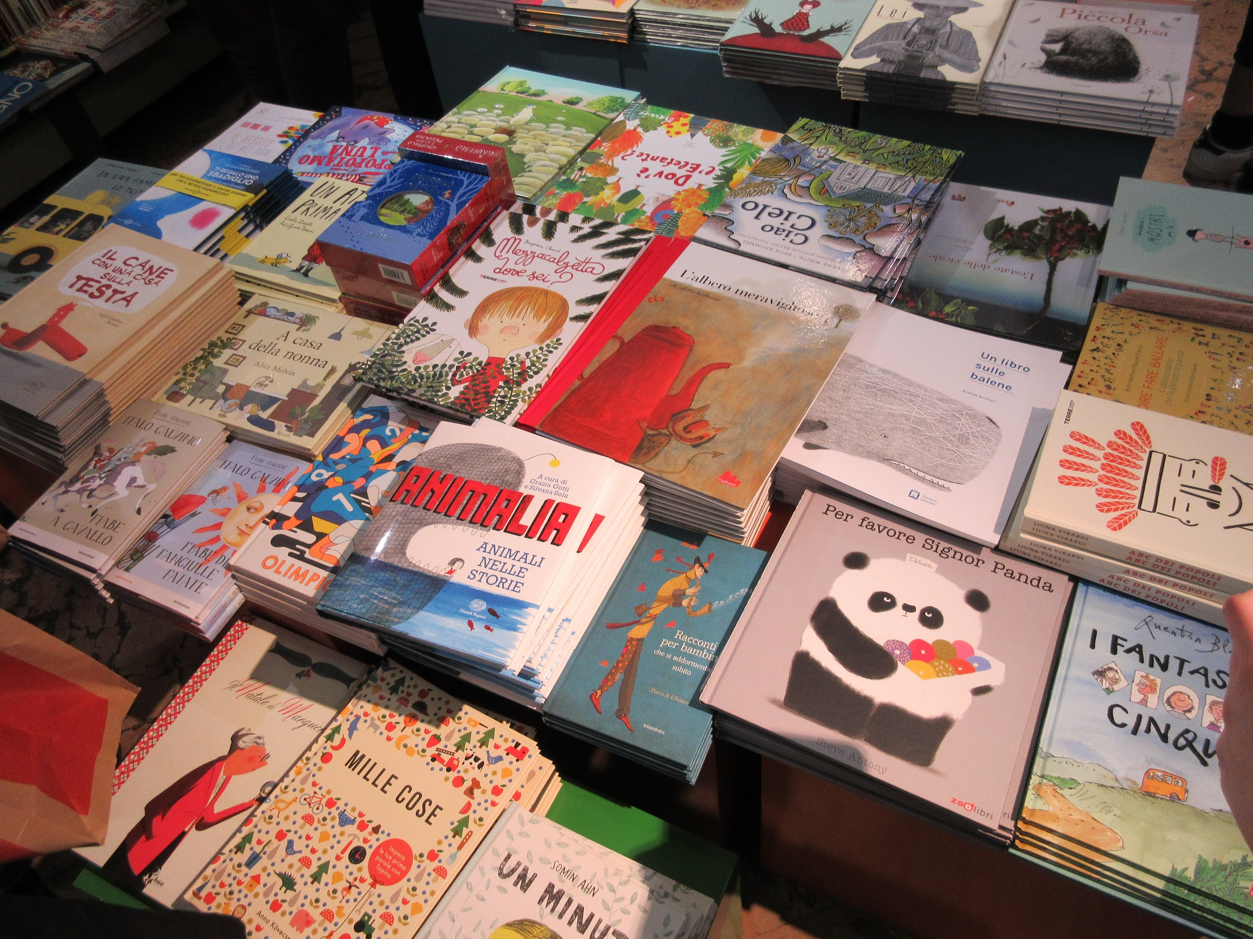
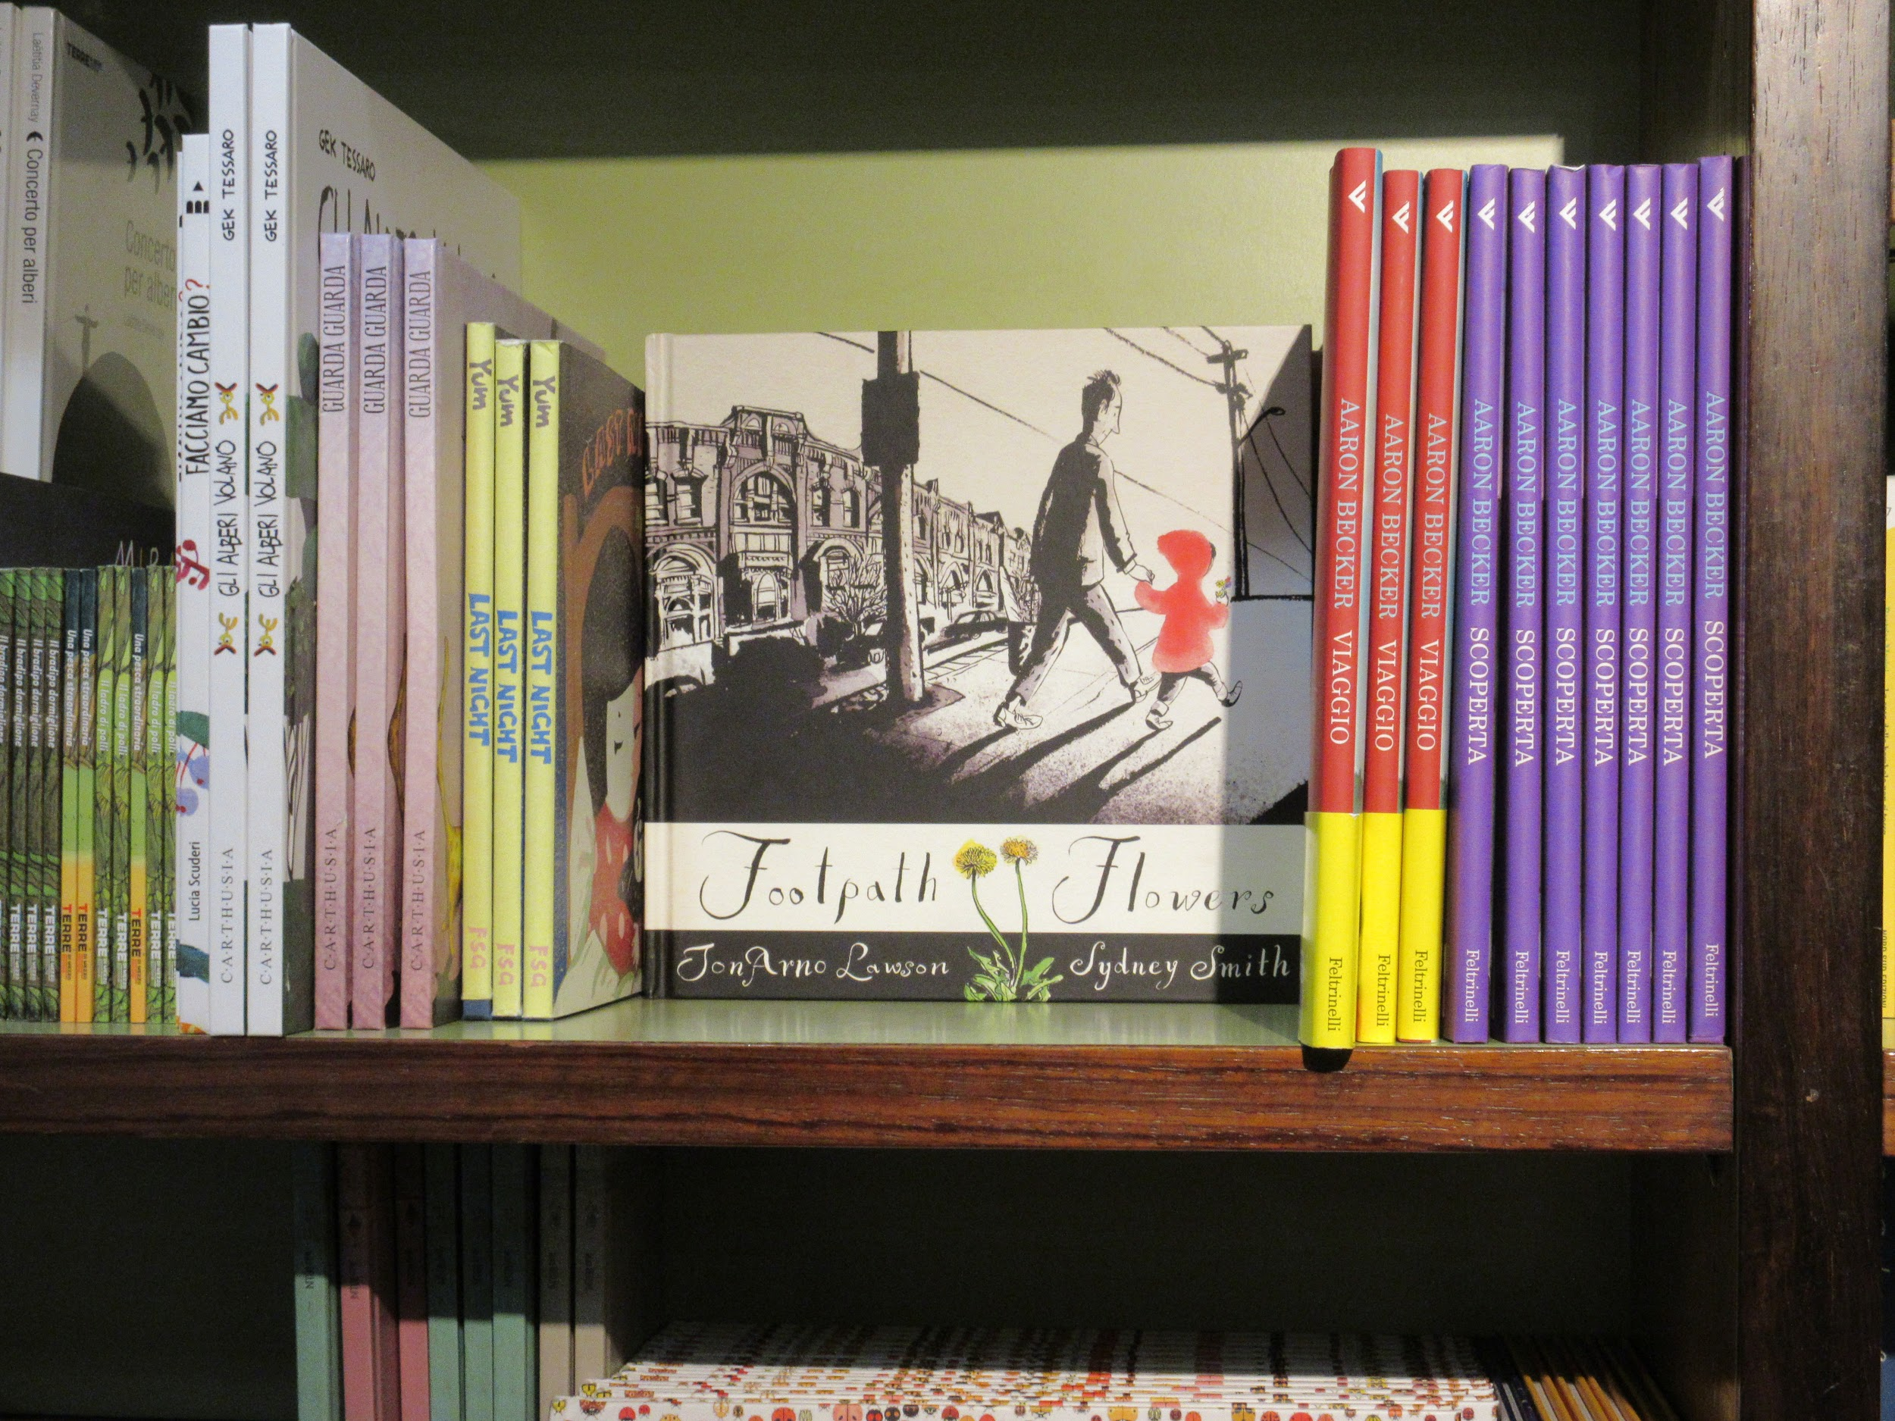
Librarians find a bookstore in Bologna.

Slide 3
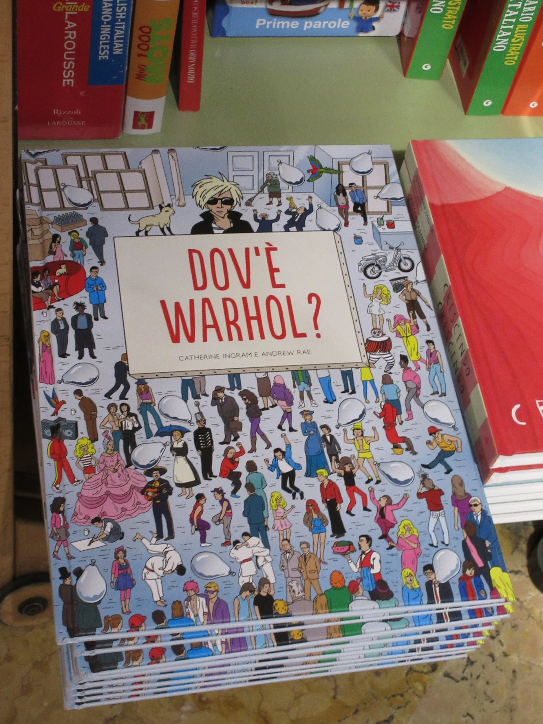
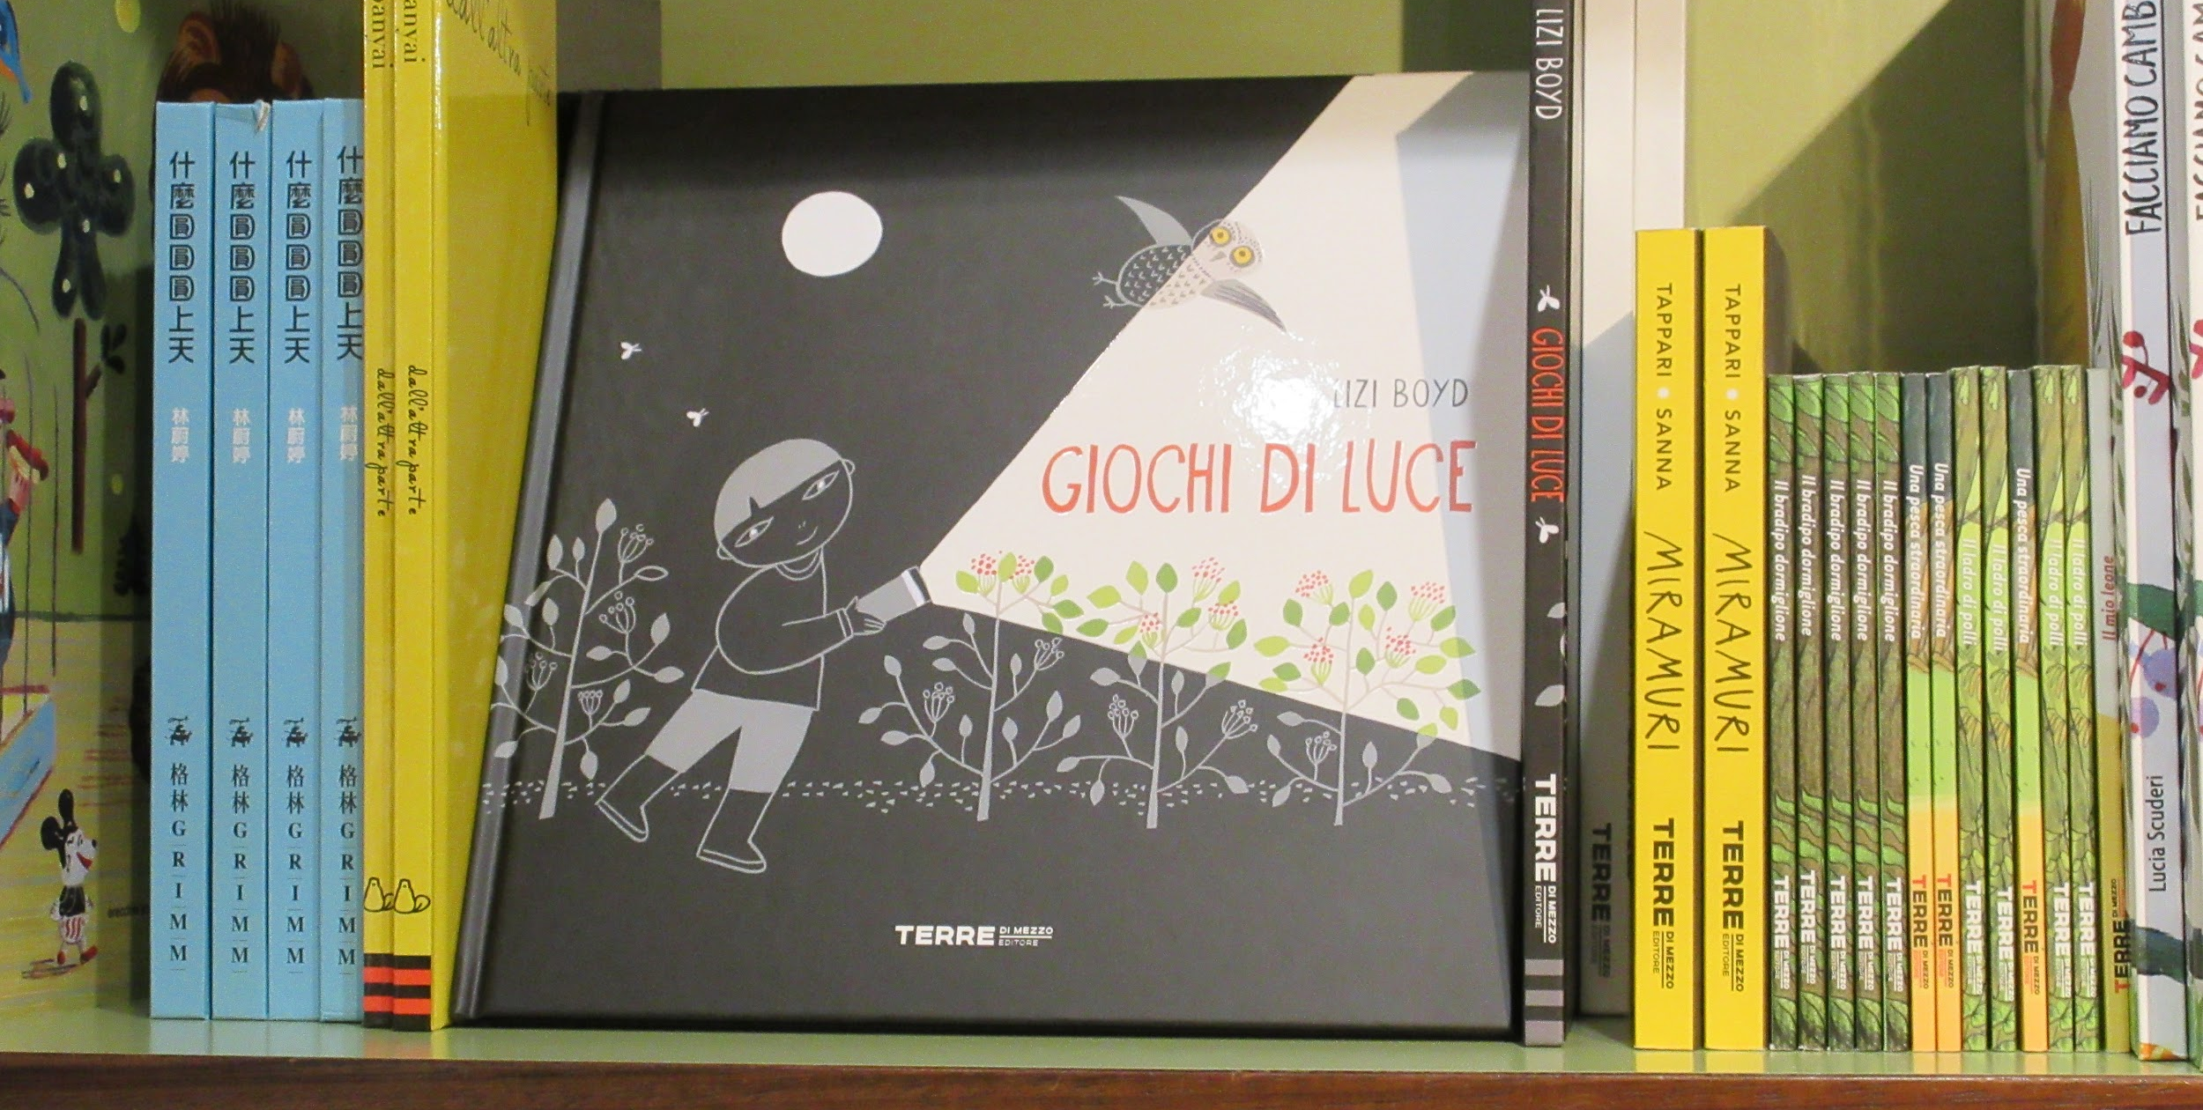
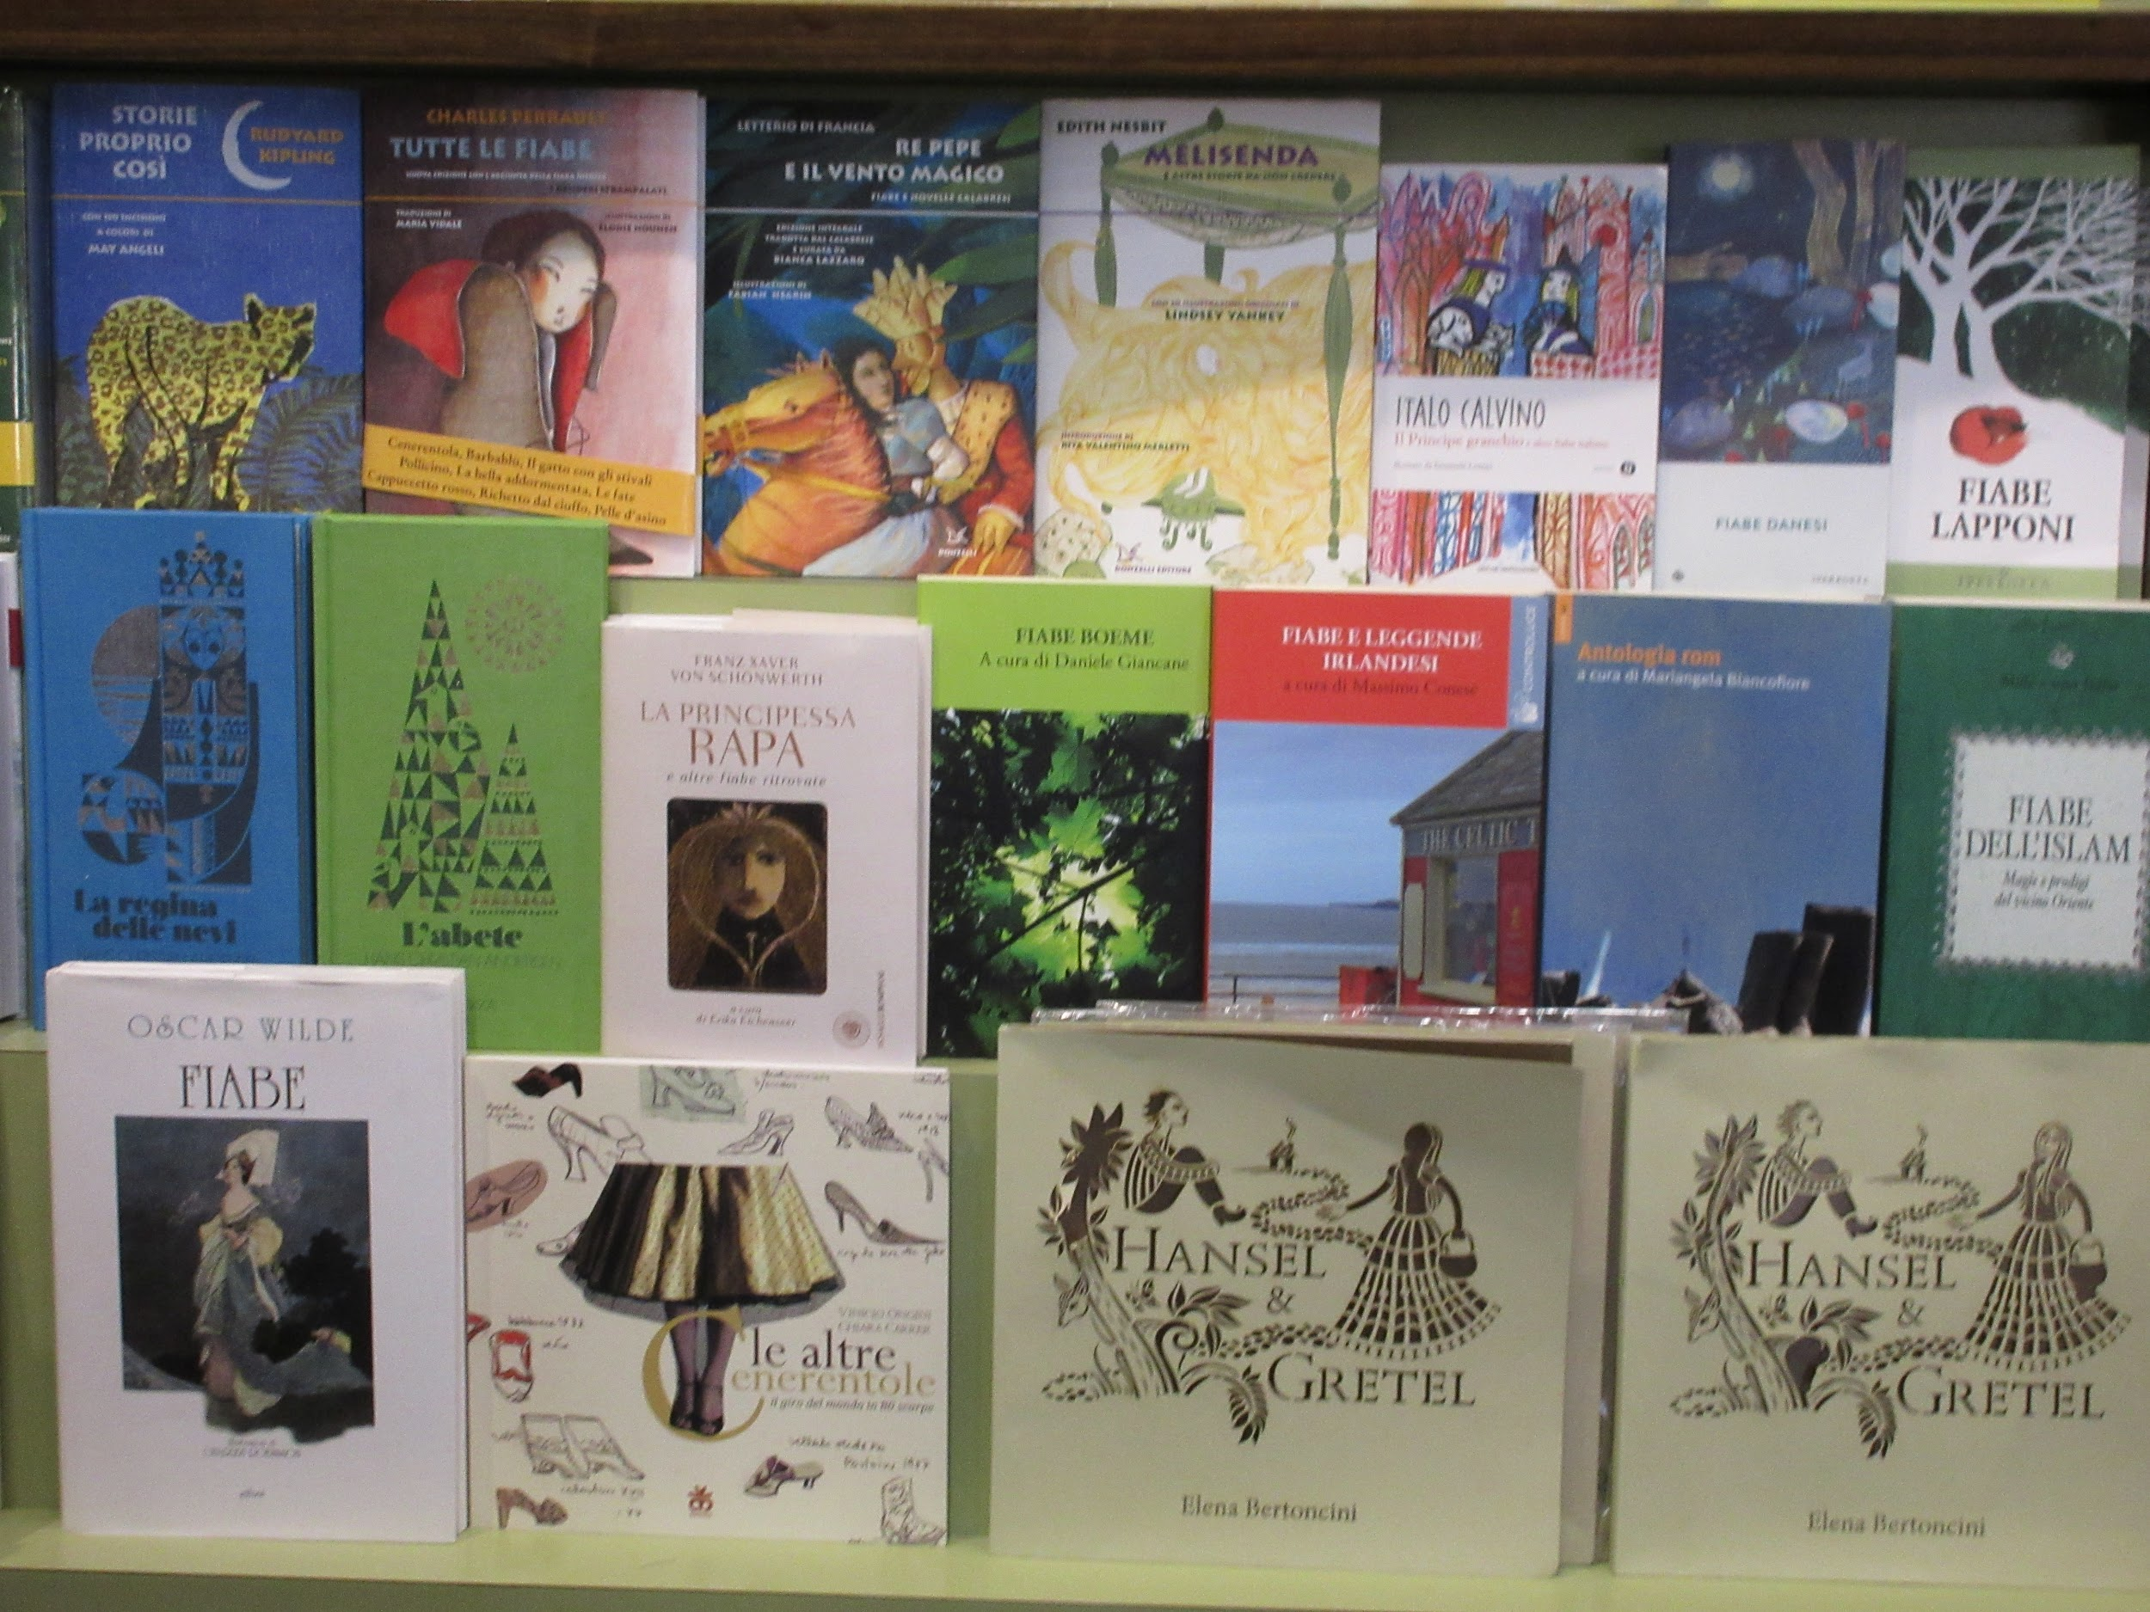

Slide 4
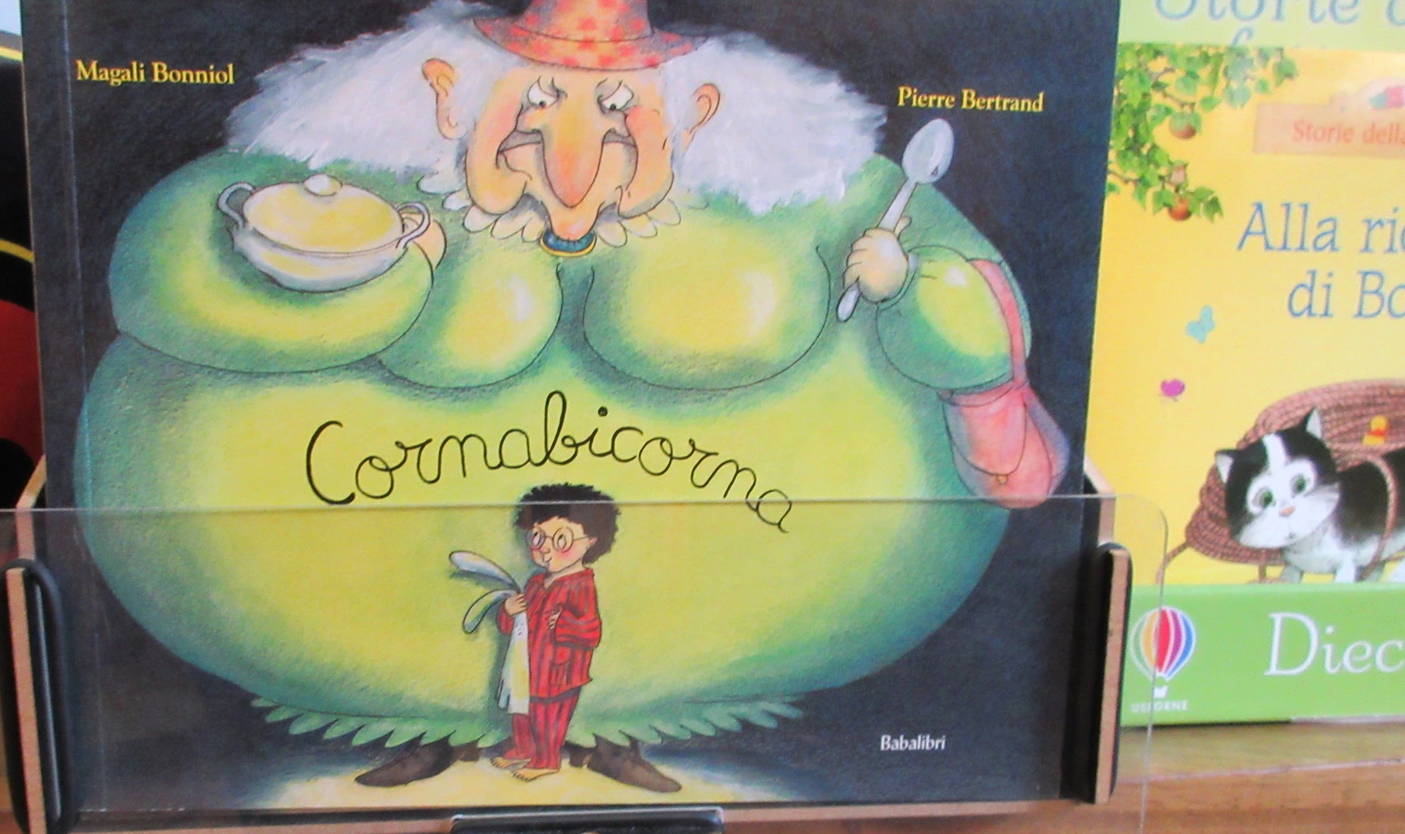
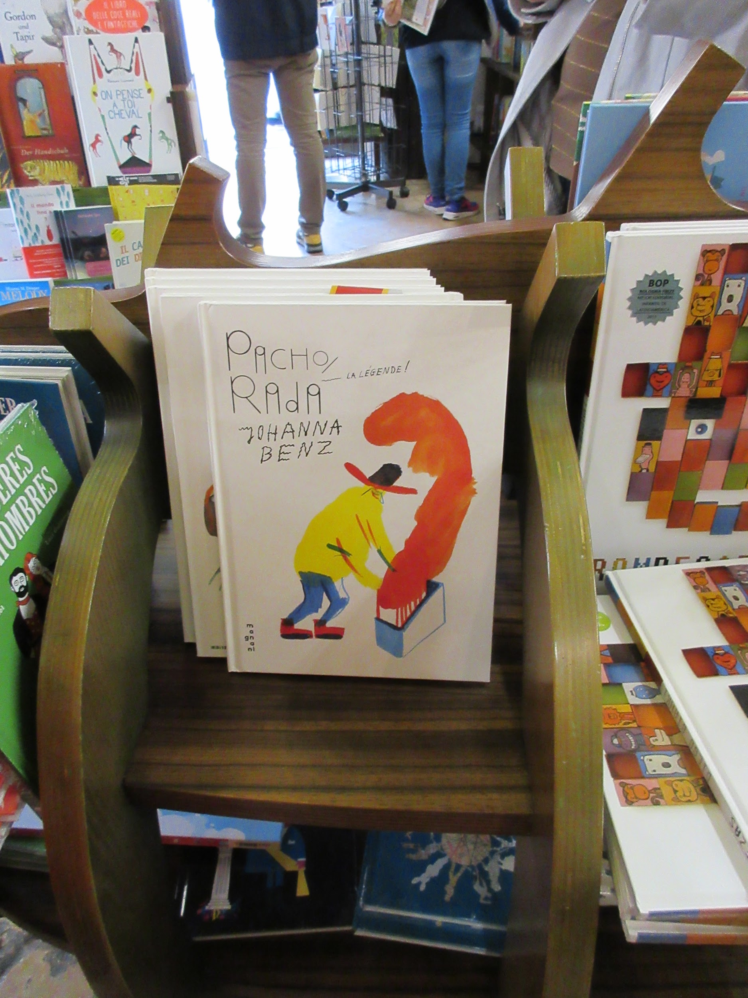
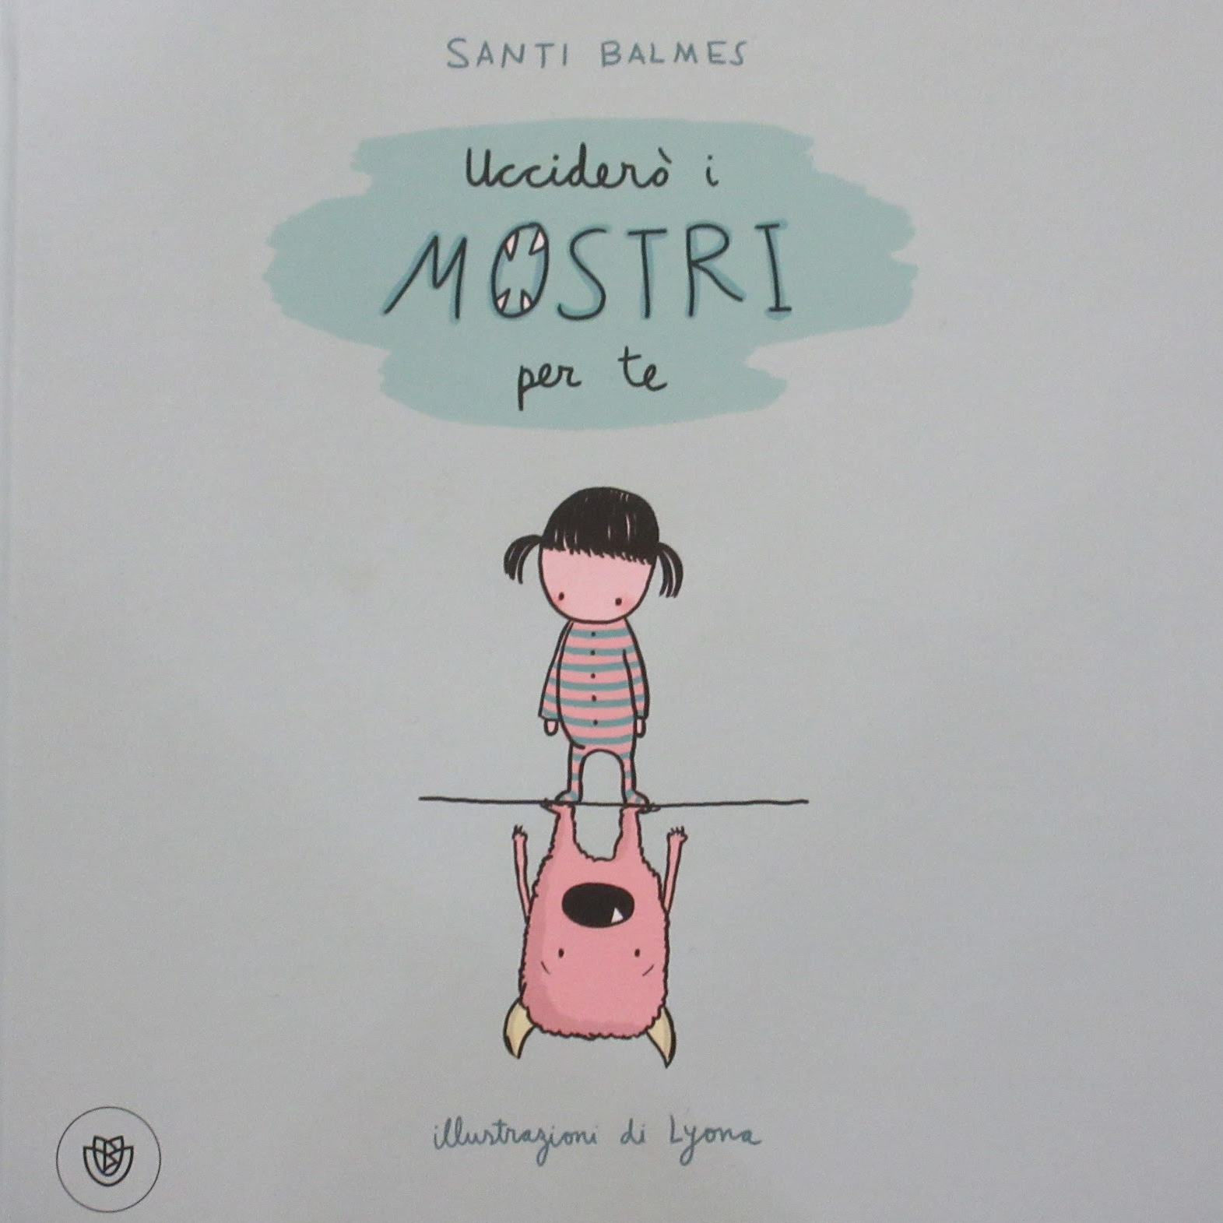
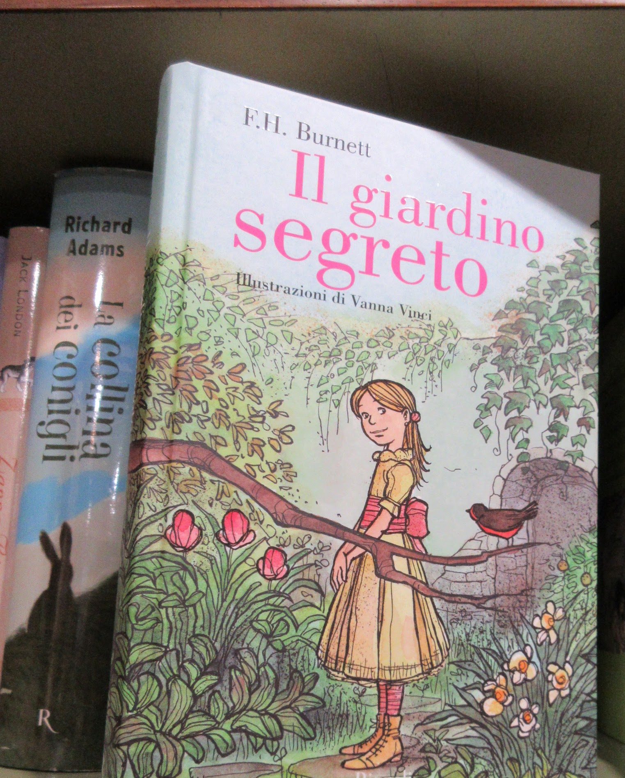
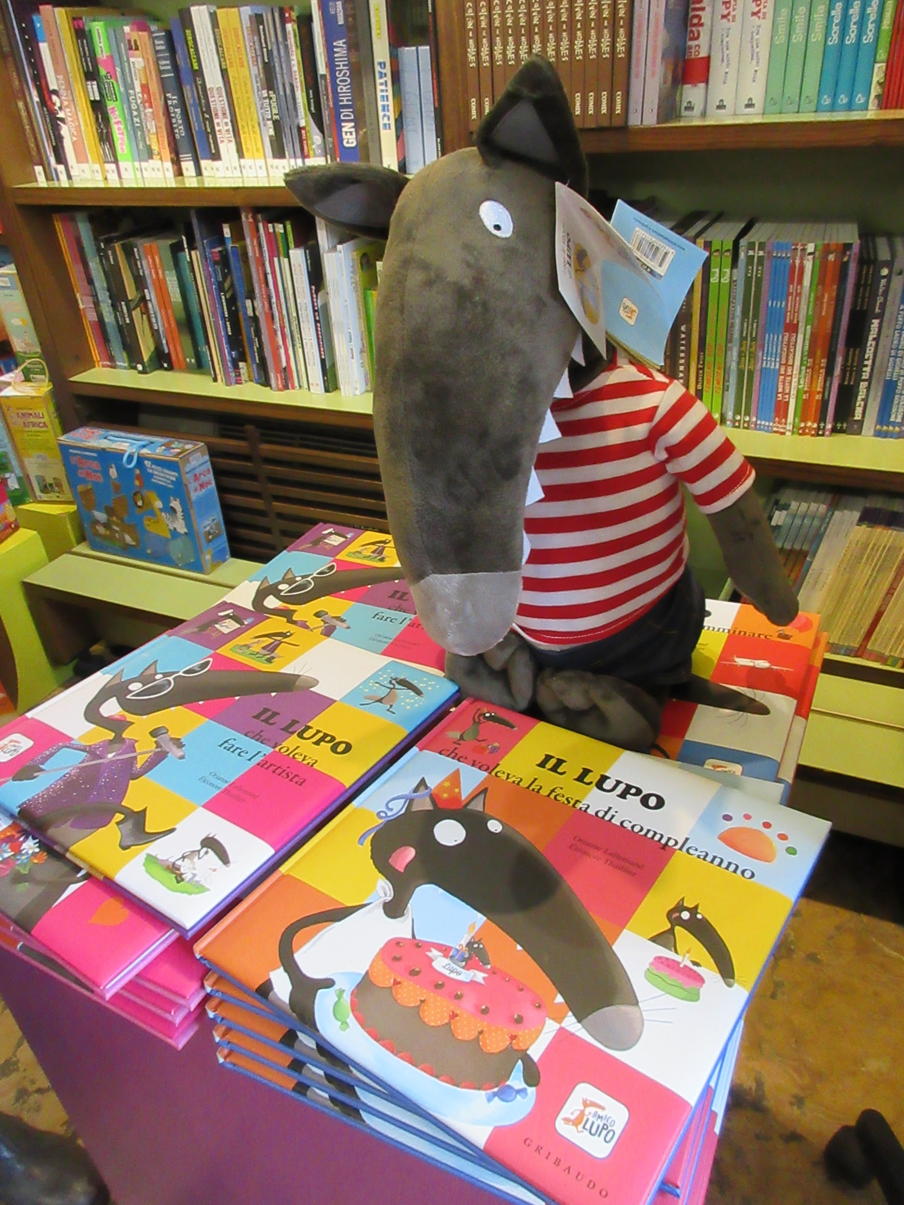

Slide 5
Schedule of Events: Monday
Monday 4/4
9:00 IBBY Inside Scoop with the President of IBBY Wally de Doncker, plus we meet with a published silent book illustrator!!!
10:00: Hasmig Chahinian
Bibliothèque nationale de France
Département Littérature et art
Centre national de la littérature pour la jeunesse - La Joie par les livres
Hall 29 D 46
11:30 Flemish Literary Fund Hall 29 D33-38 Elise Vanoosthuyse
2: Hans Christian Anderson award ceremony
Illustrator’s Café, Bologna Children's Book Fair
Announcement of the winners of the 2016 Andersen Awards
Announcement of the winners of the 2016 IBBY-Asahi Reading Promotion Award
IBBY Project Programme
International Children's Book Day: 2016 sponsor IBBY Brazil
Information about the 35th IBBY Congress 2016 in Auckland, New Zealand
Bookbird
2:30 Reception at IBBY stand: 15:30, Hall 29, stand A 51

Slide 6
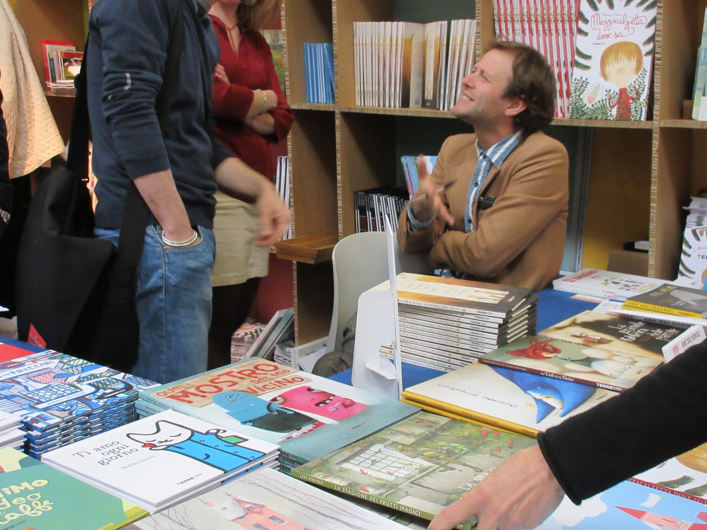
Schedule of Events: Tuesday
Tuesday 4/5
12.:00 White Raven: Multilingual Books
2:00 Julia Eccleshare Children’s Editor at the Guardian, UK Publisher
4: Yurika Yokota Yoshida, CEO
Japan Foreign-Rights Centre
Guest appearance by author Mac Barnett, “Sam and Dave Dig a Hole,” Caldecott winner.

Slide 7
President of IBBY Wally de Doncker

Slide 8
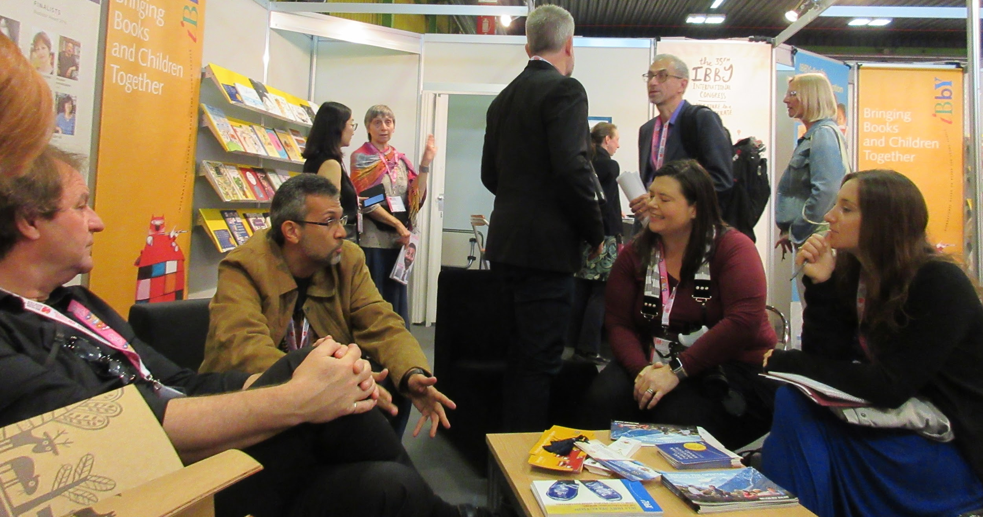
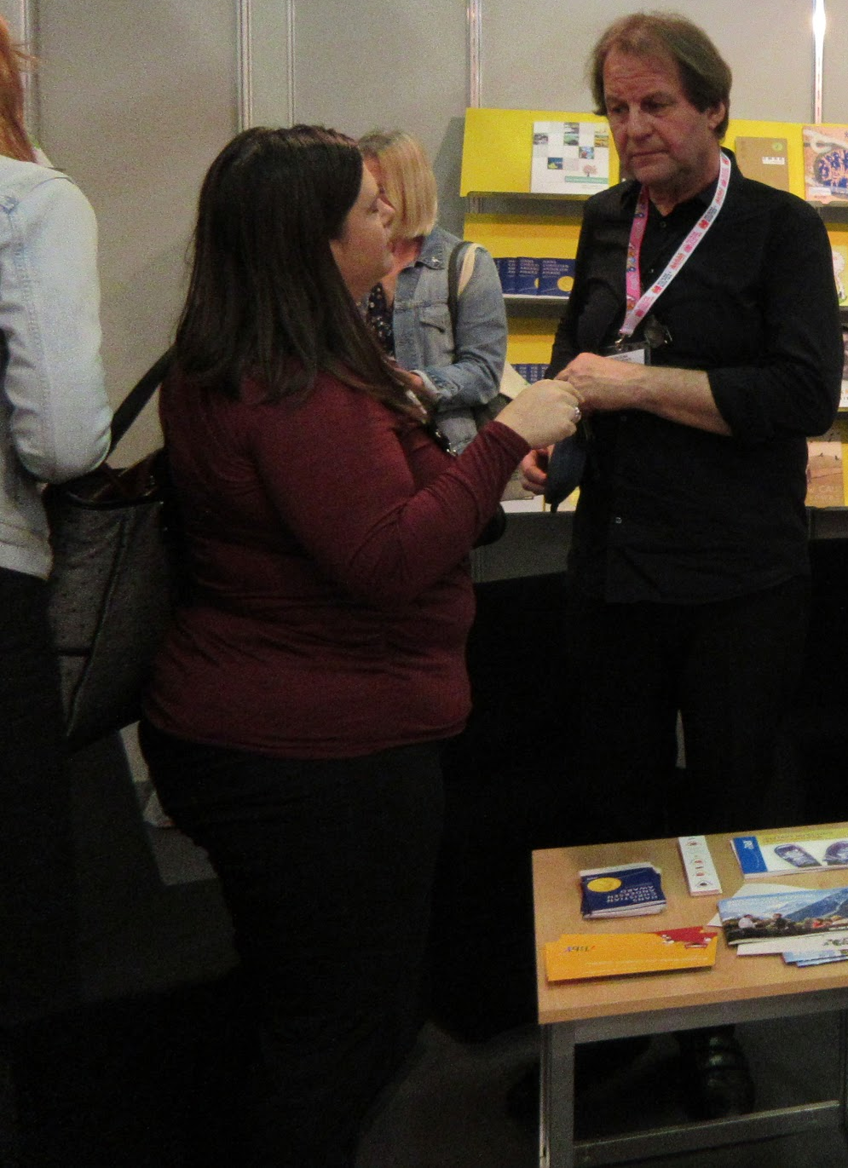
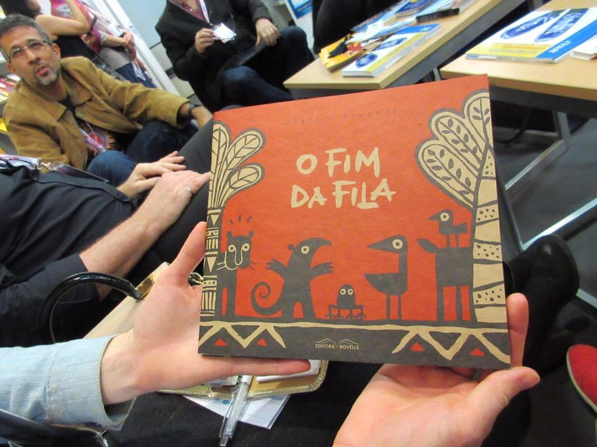
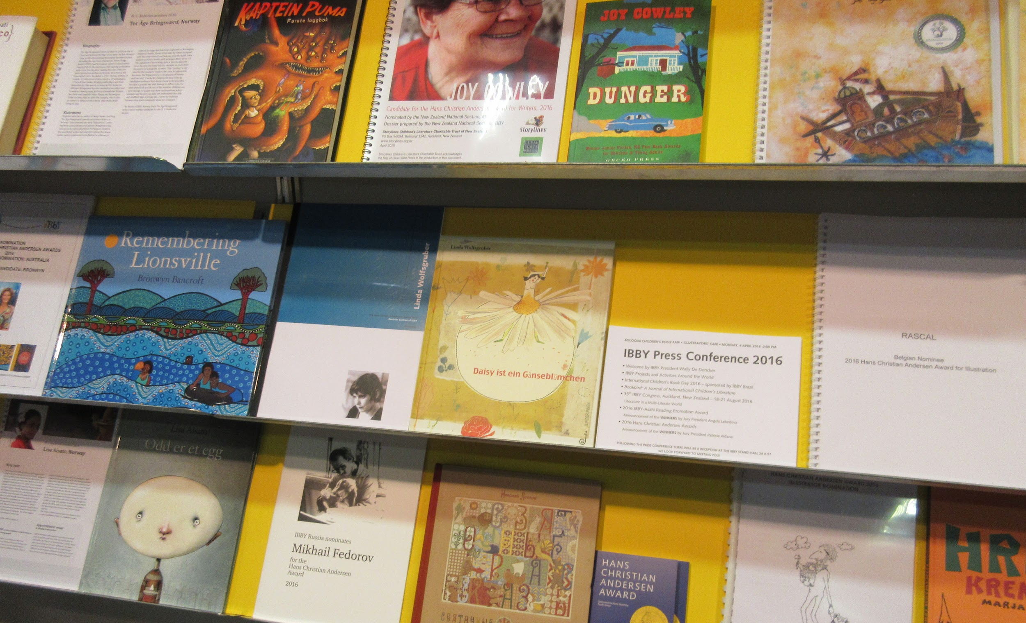
Wally de Doncker, President of IBBY and all around wonderful human being, sharing with us the importance of IBBY and librarians for helping displaced people like refugees who are being refused access to libraries.

Slide 9
Hasmig Chahinian
Bibliothèque nationale de France
Département Littérature et art
Centre national de la littérature pour la jeunesse - La Joie par les livres

Slide 10
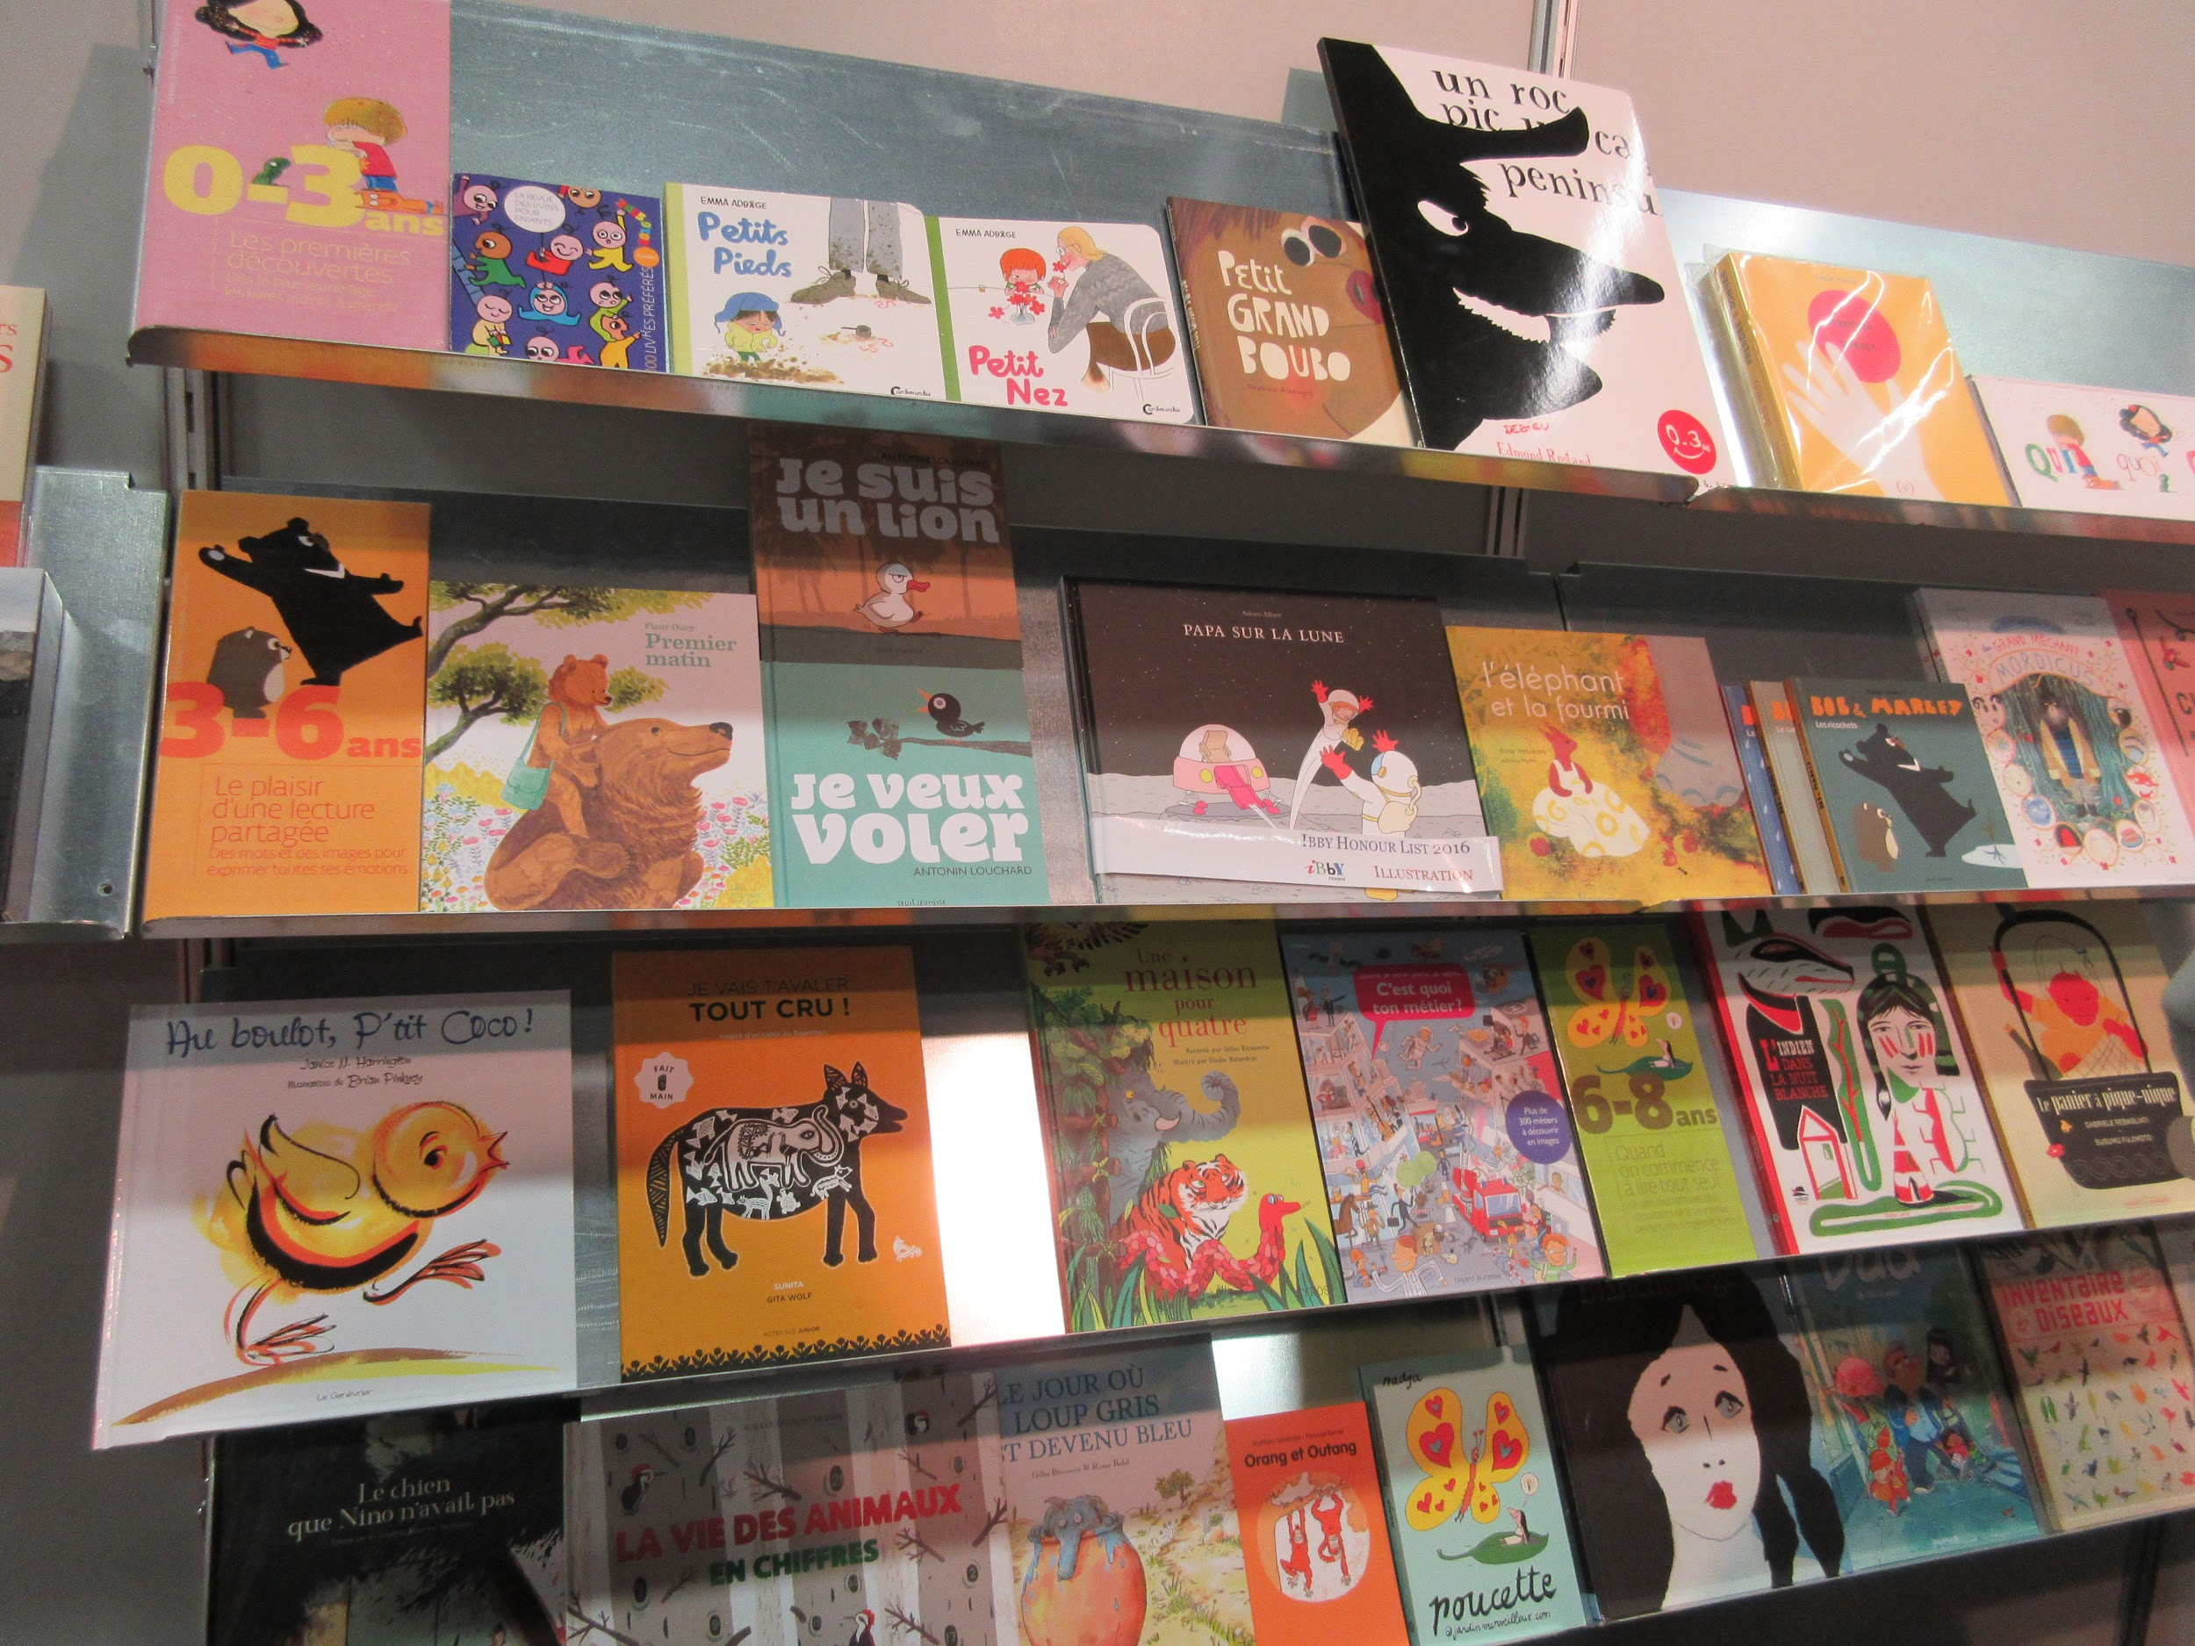
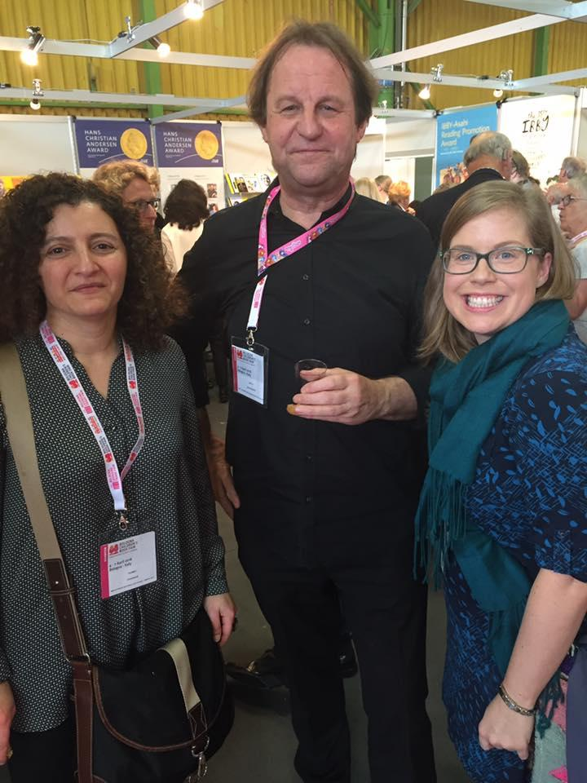
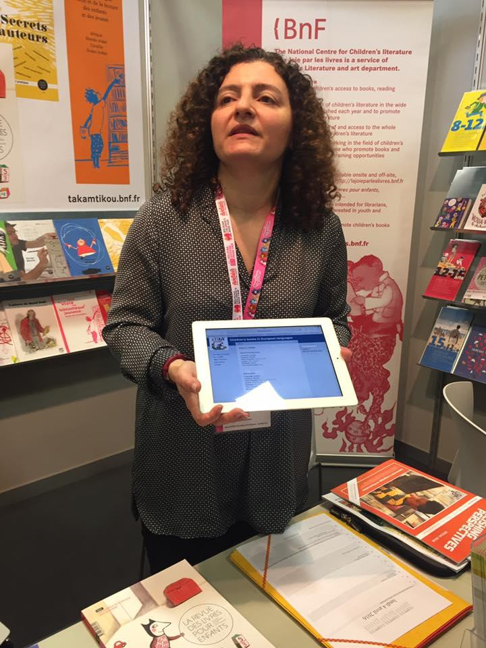
10 AM Meeting Hasmig Chahinian

Slide 11
11:30 Flemish Literary Fund Elise Vanoosthuyse

Slide 12
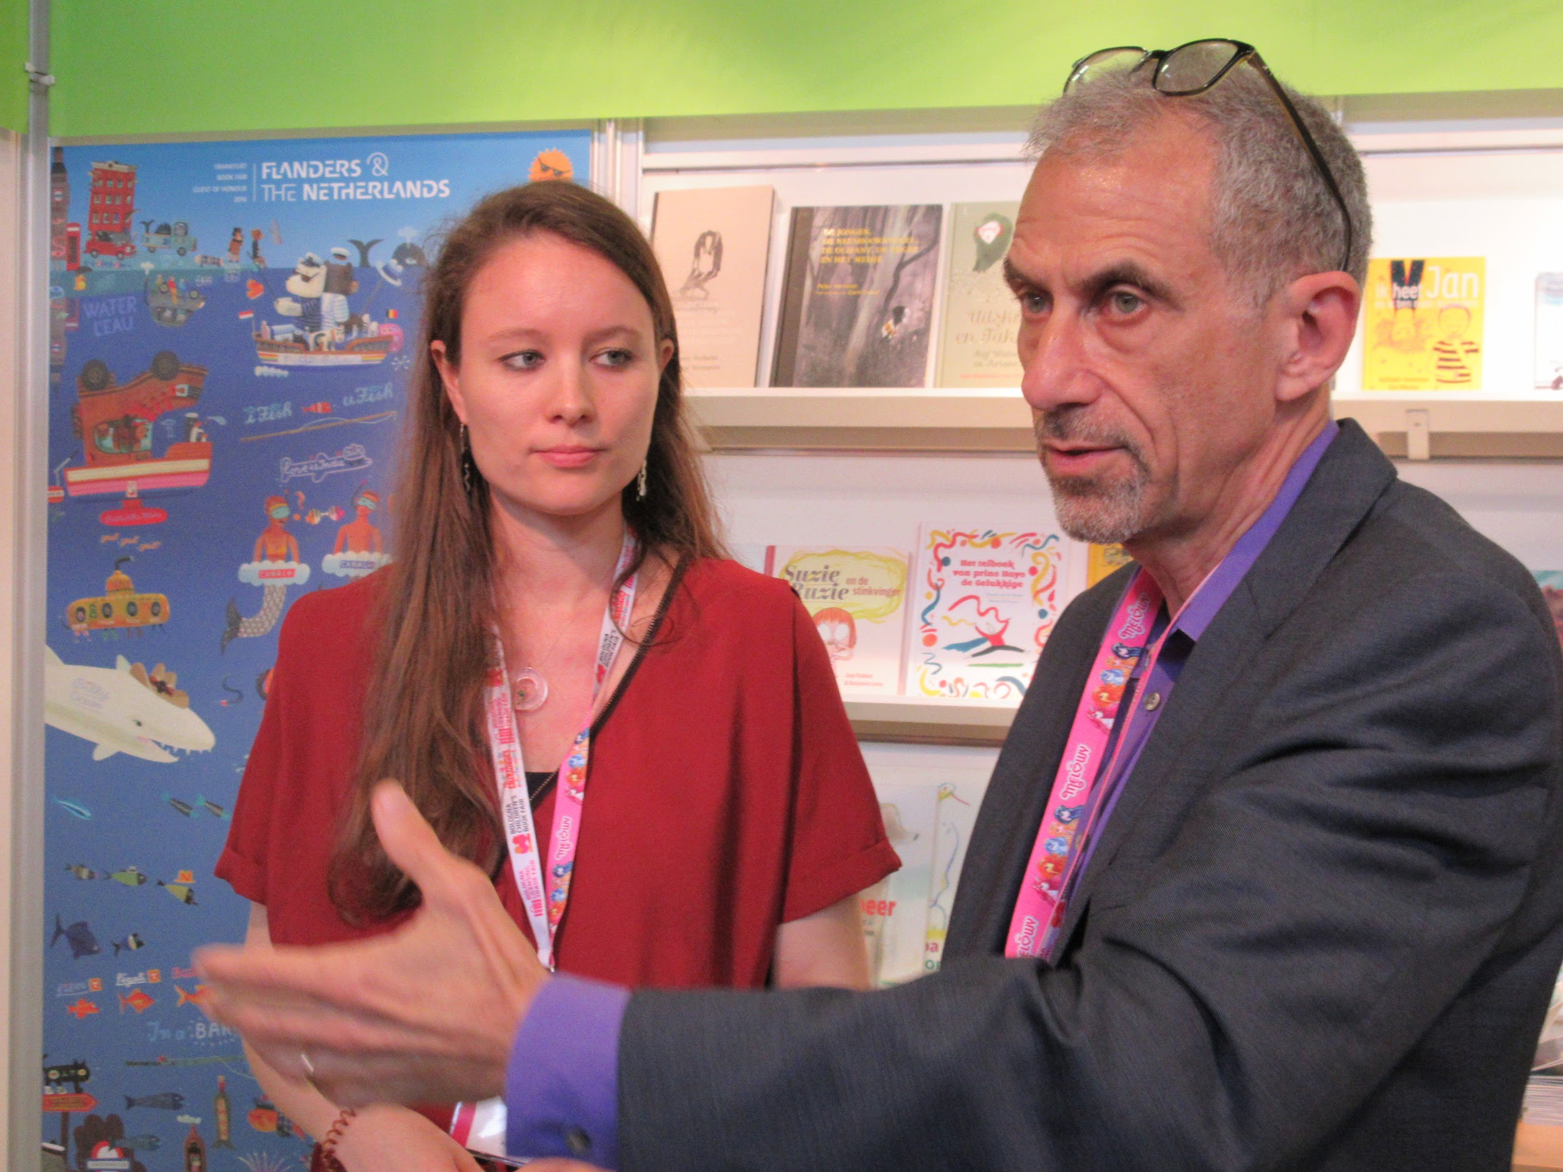
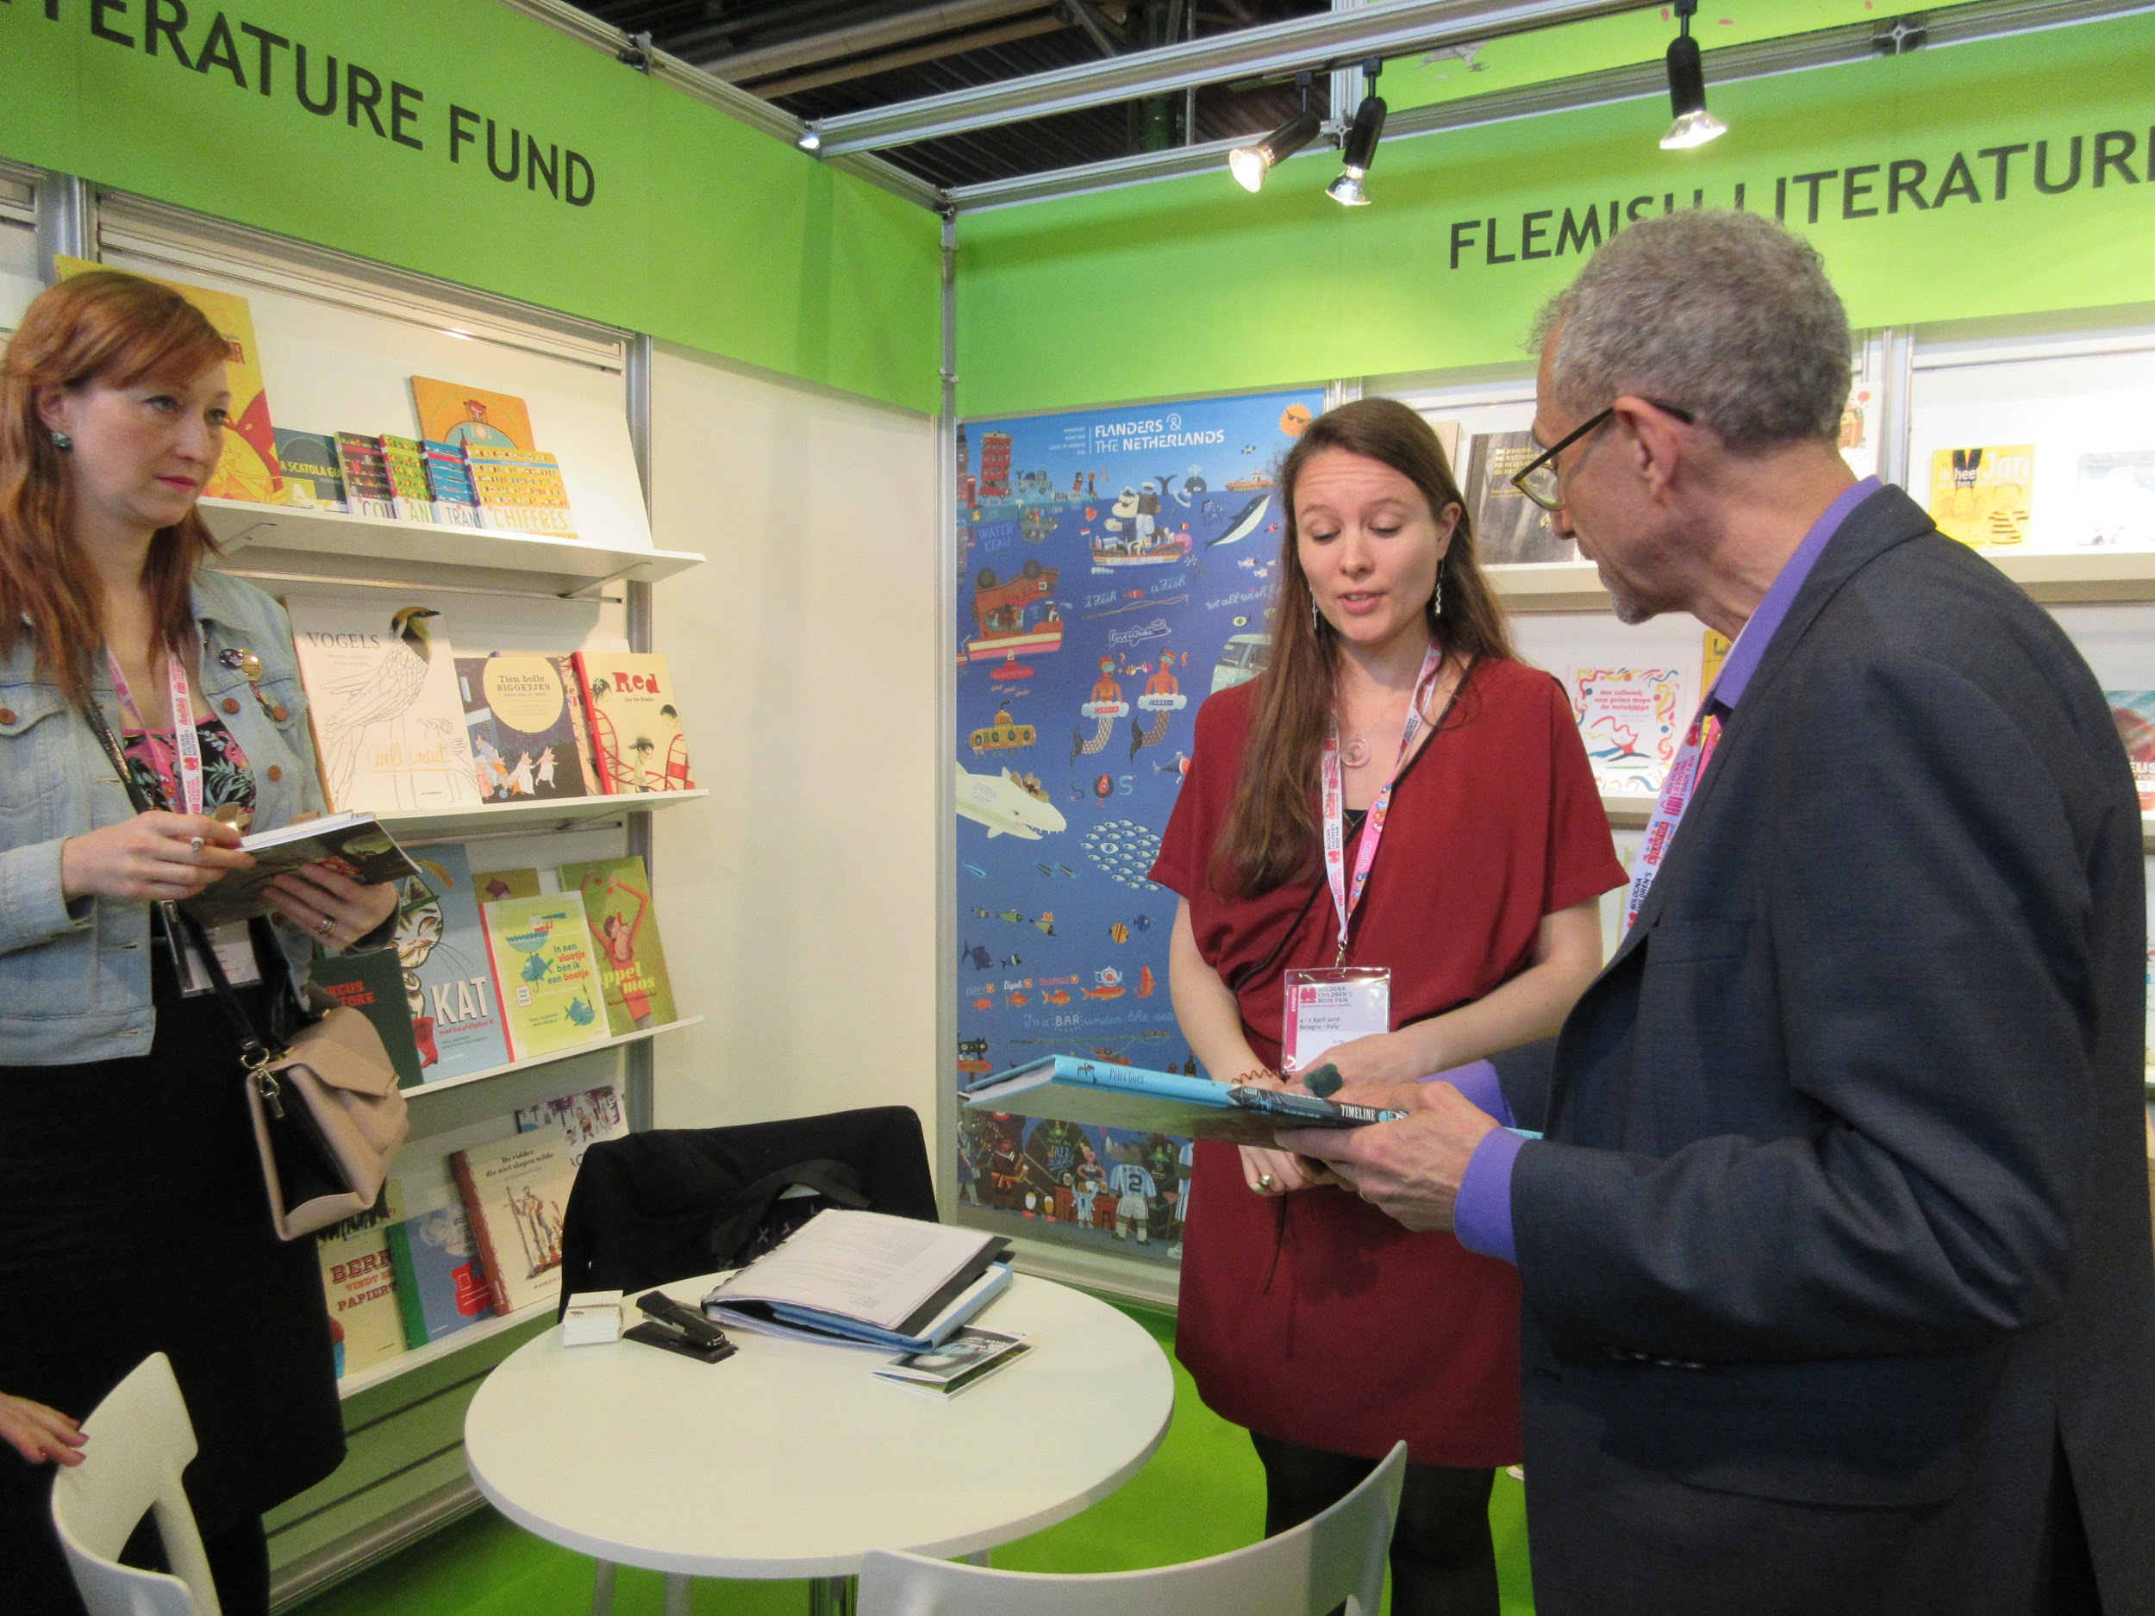
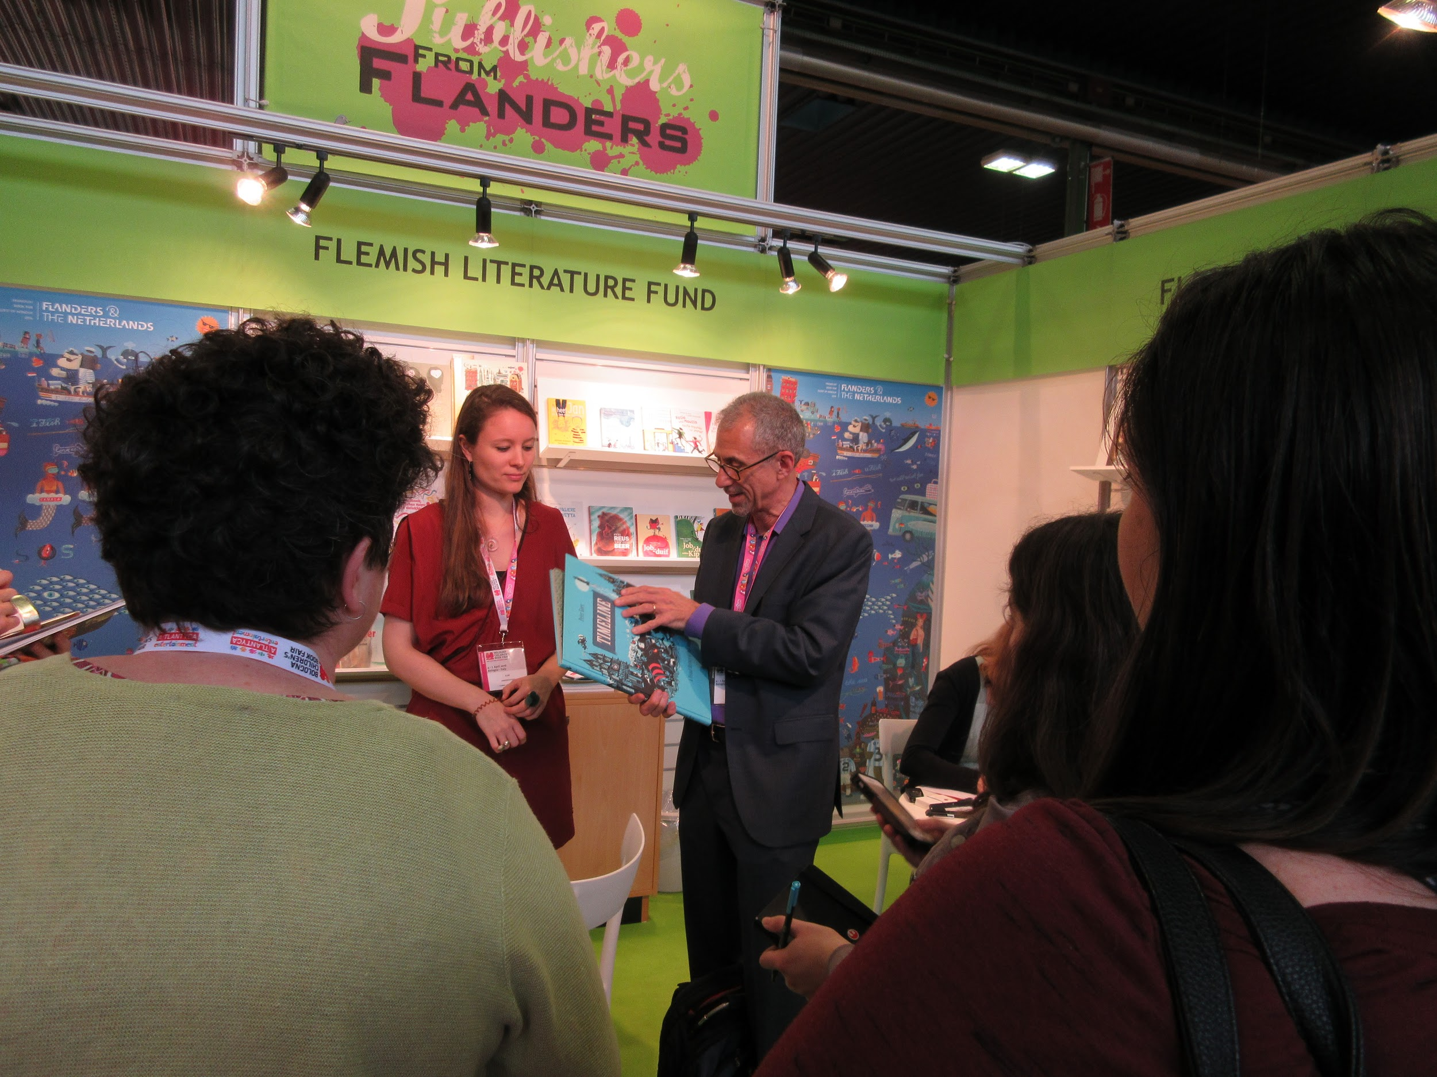
11:30 Meeting Elise Vanoosthuyse

Slide 13
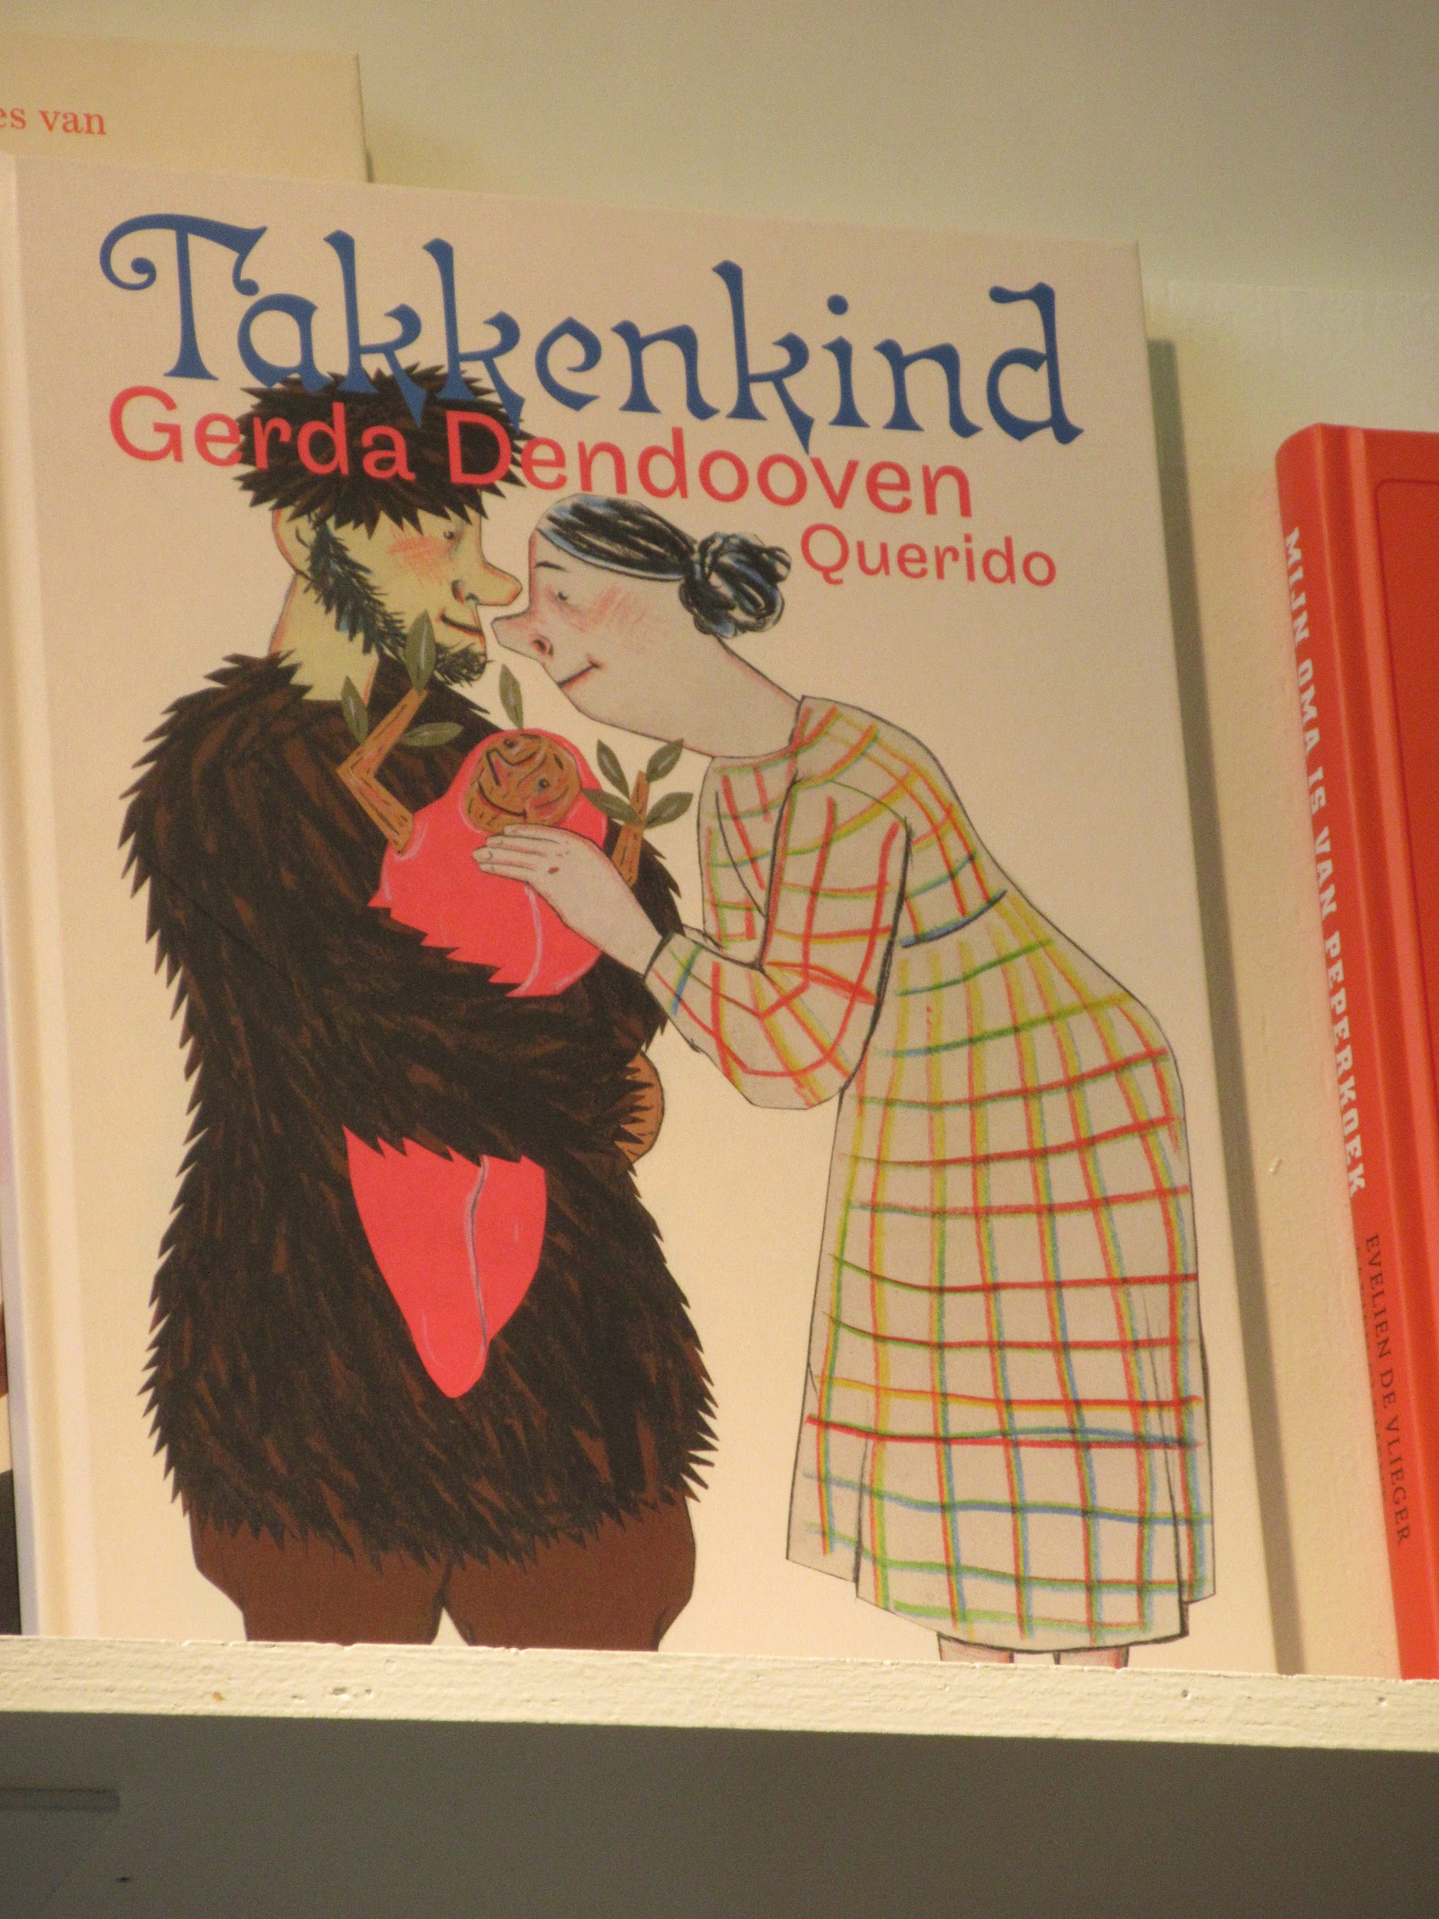
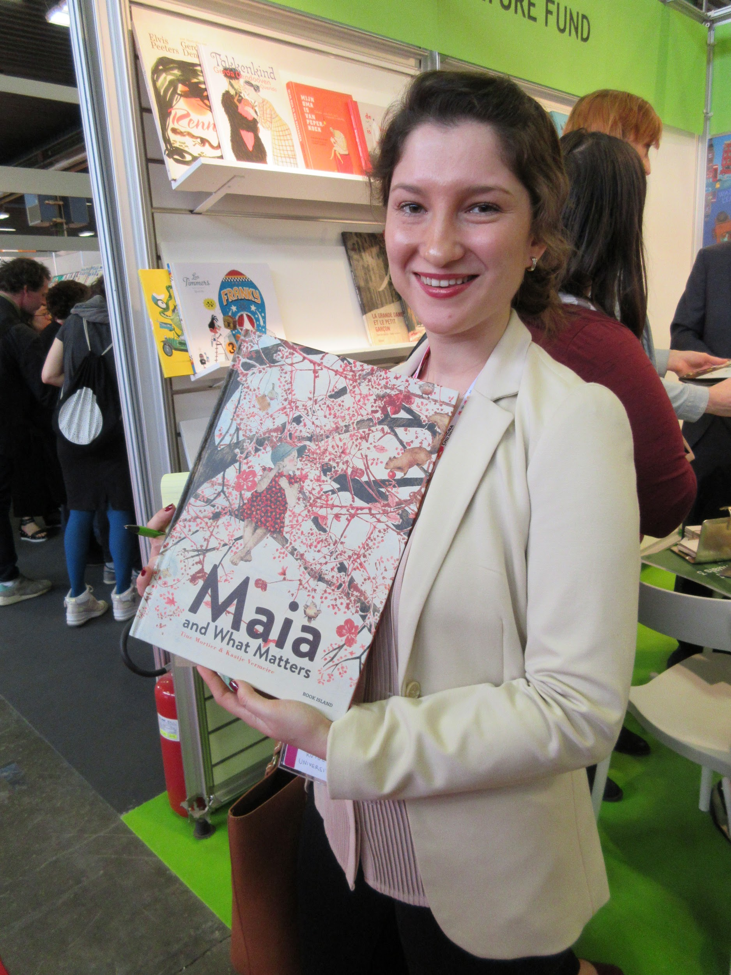
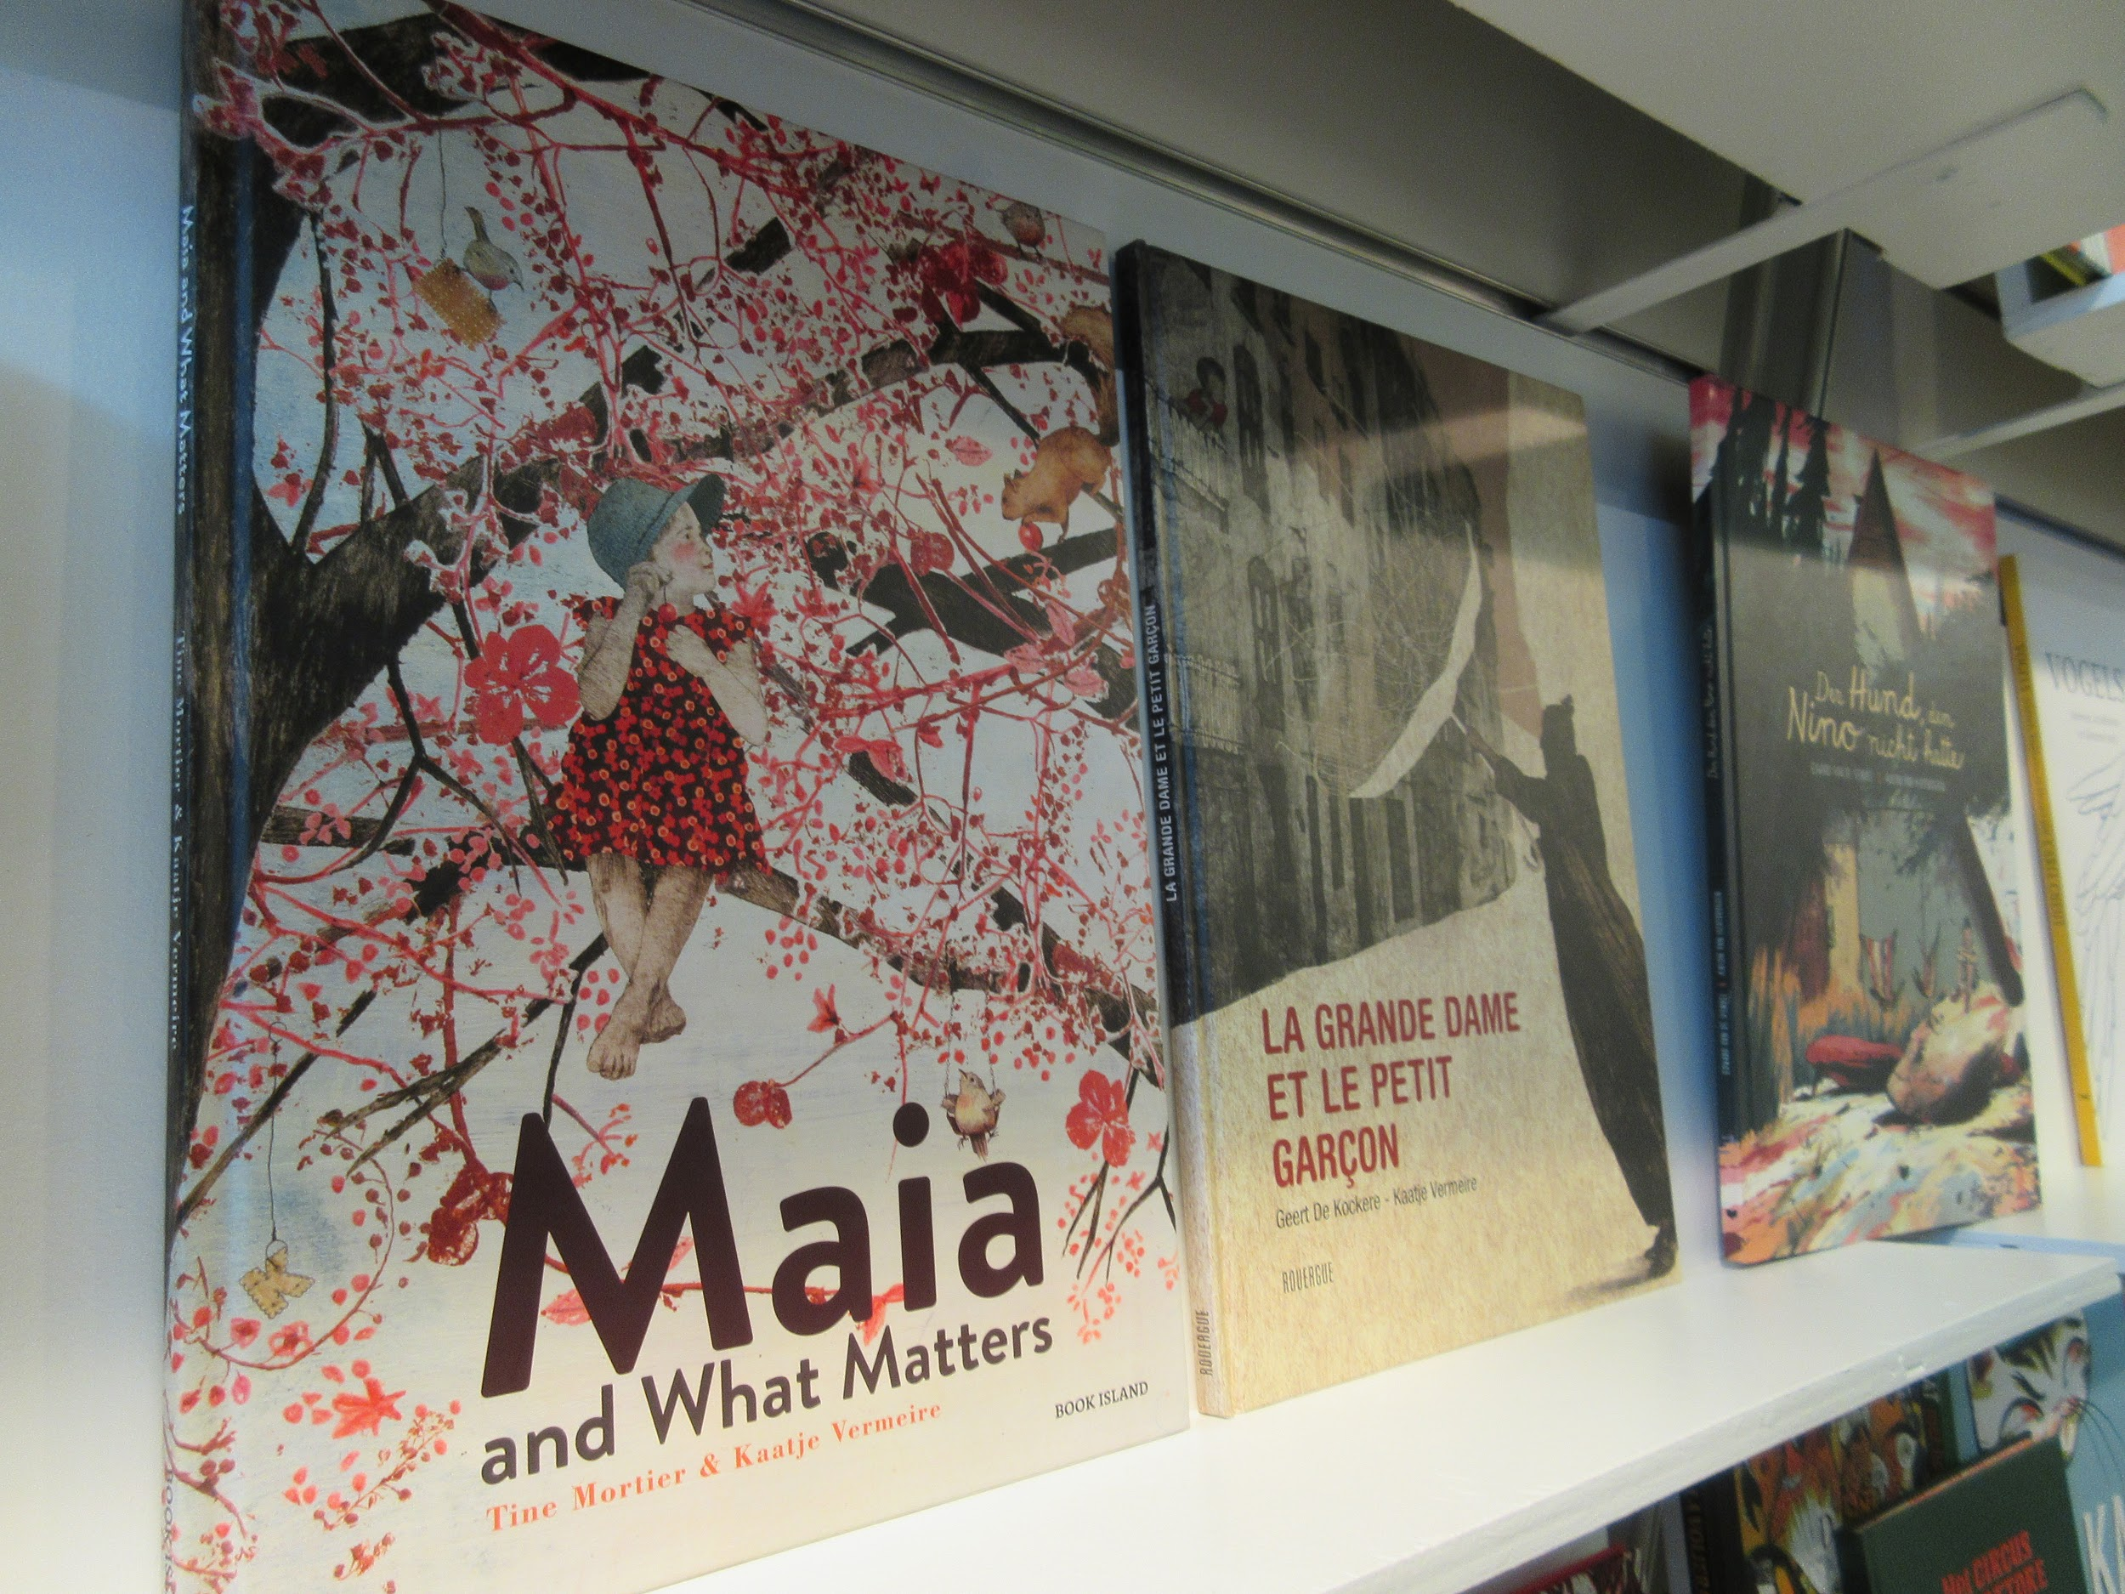
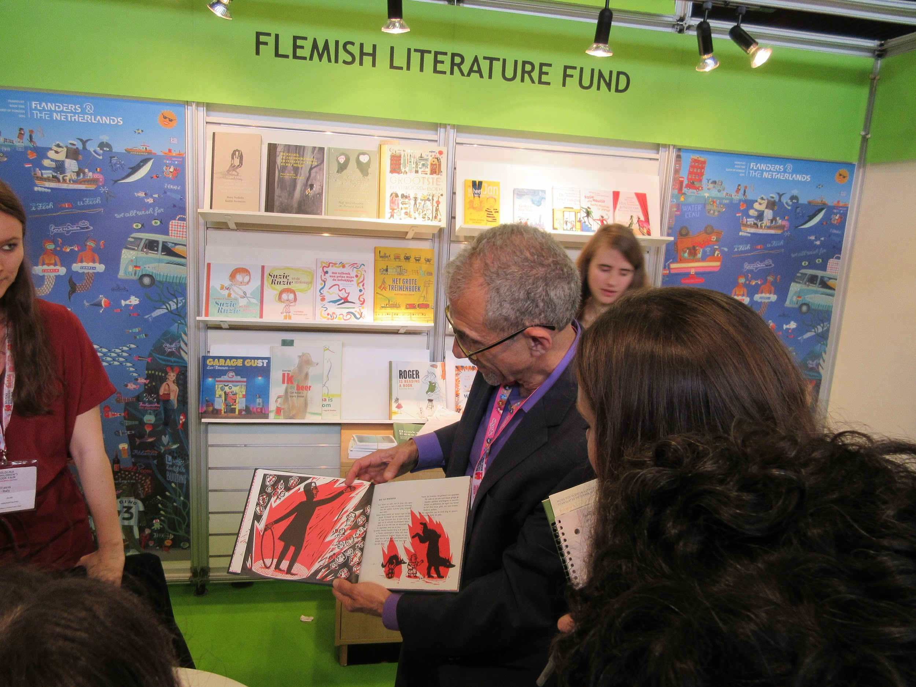

Slide 14
Hans Christian Anderson Awards Ceremony

Slide 15
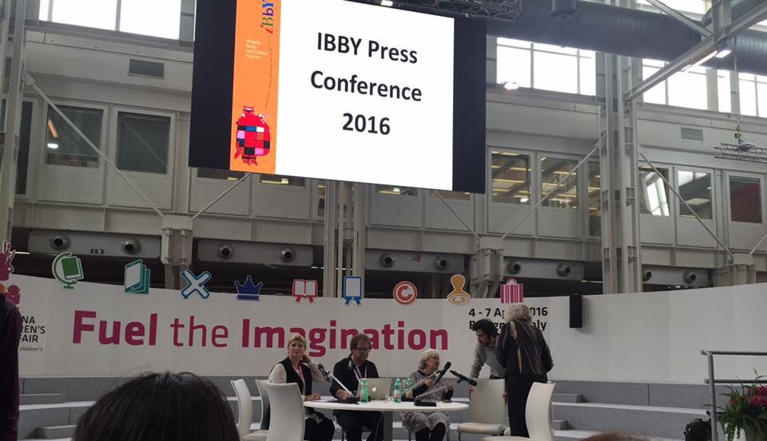
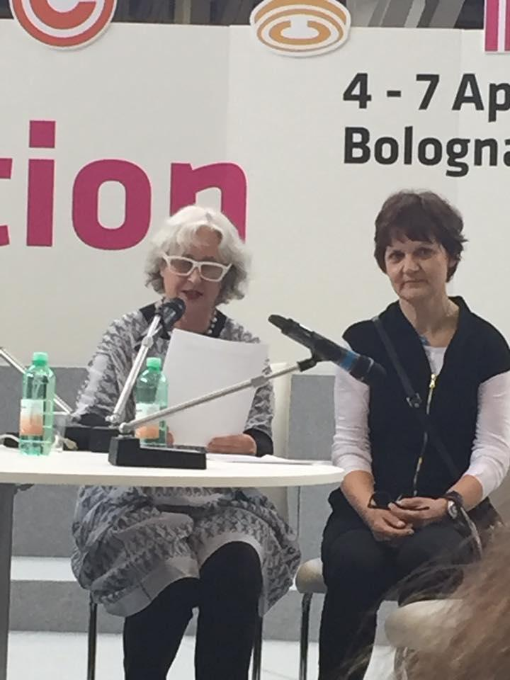
Hans Christian Anderson Awards Ceremony

Slide 16
And the award goes to….
The Hans Christian Andersen Award Jury of the International Board on Books for Young People (IBBY) has named:
Cao Wenxuan from China winner of the 2016 Hans Christian Andersen Author Award
Rotraut Susanne Berner from Germany winner of the 2016 Hans Christian Andersen Illustrator Award.
Our guest lecturer Helen Wang translated for Cao Wenxuan!!!!

Slide 17
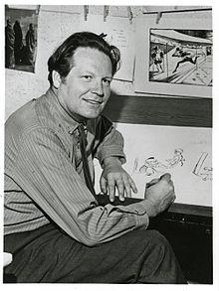
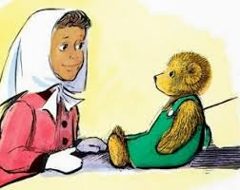
Dreams do come true...meeting Don Freeman’s Son, Roy!

Slide 18
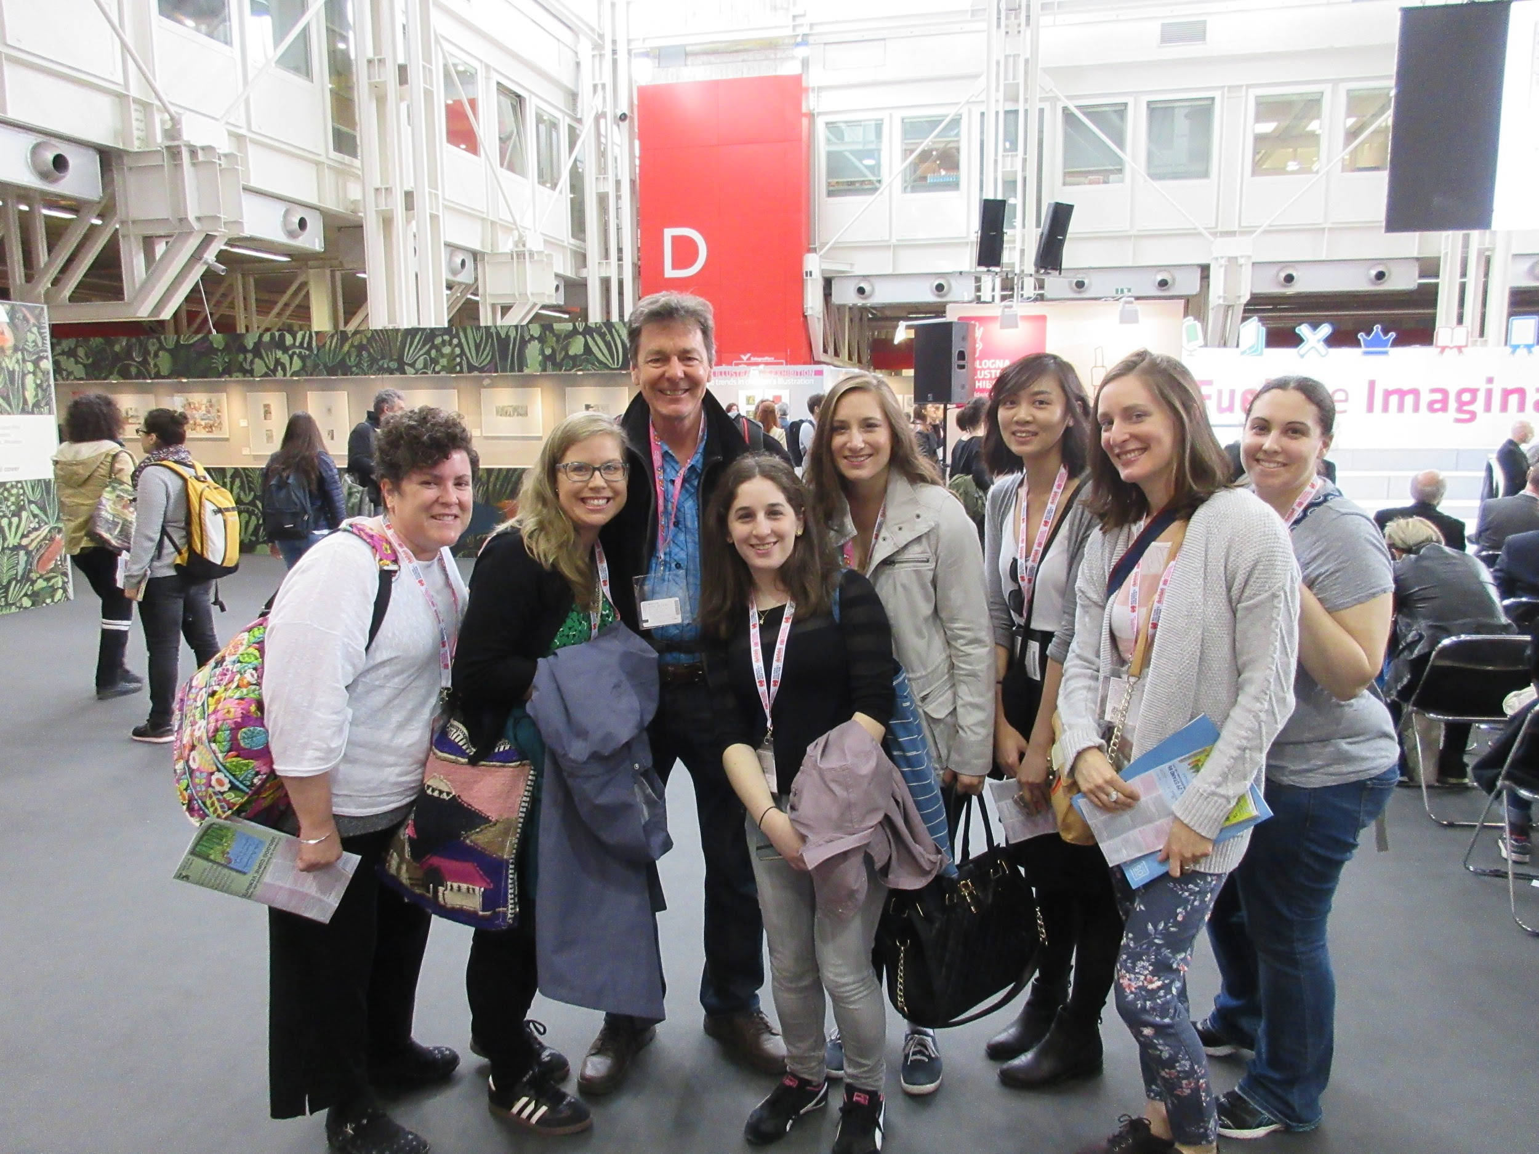
Roy Freeman

Slide 19
IBBY Reception

Slide 20
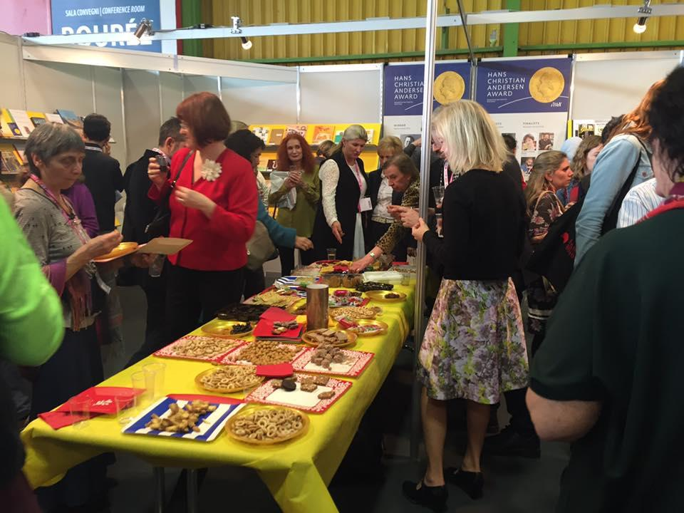
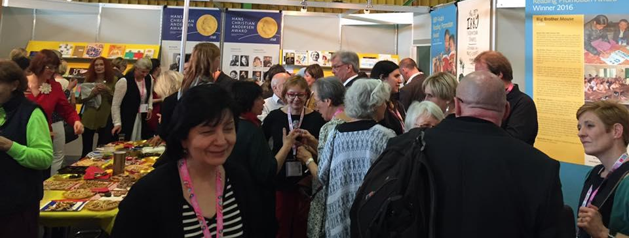
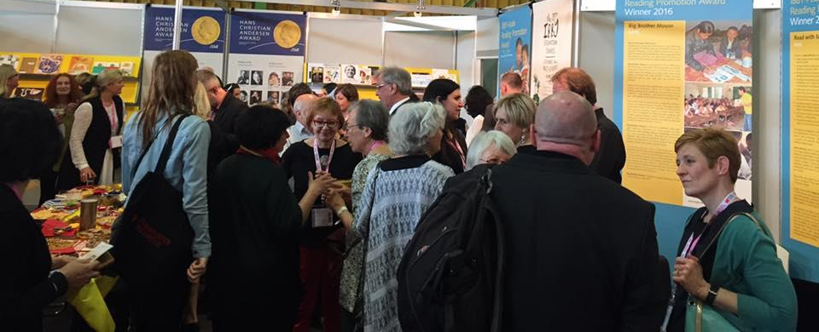
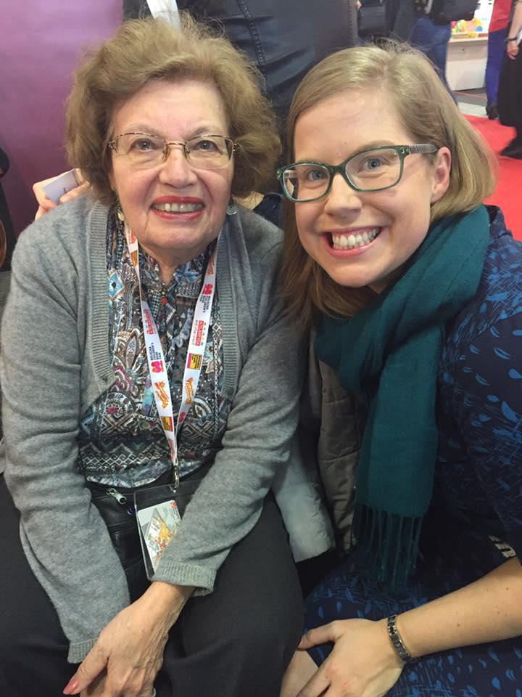
IBBY Reception, and my new Babaanne, Turkish grandmother, and Hans Christian Anderson Award Nominee...

Slide 21
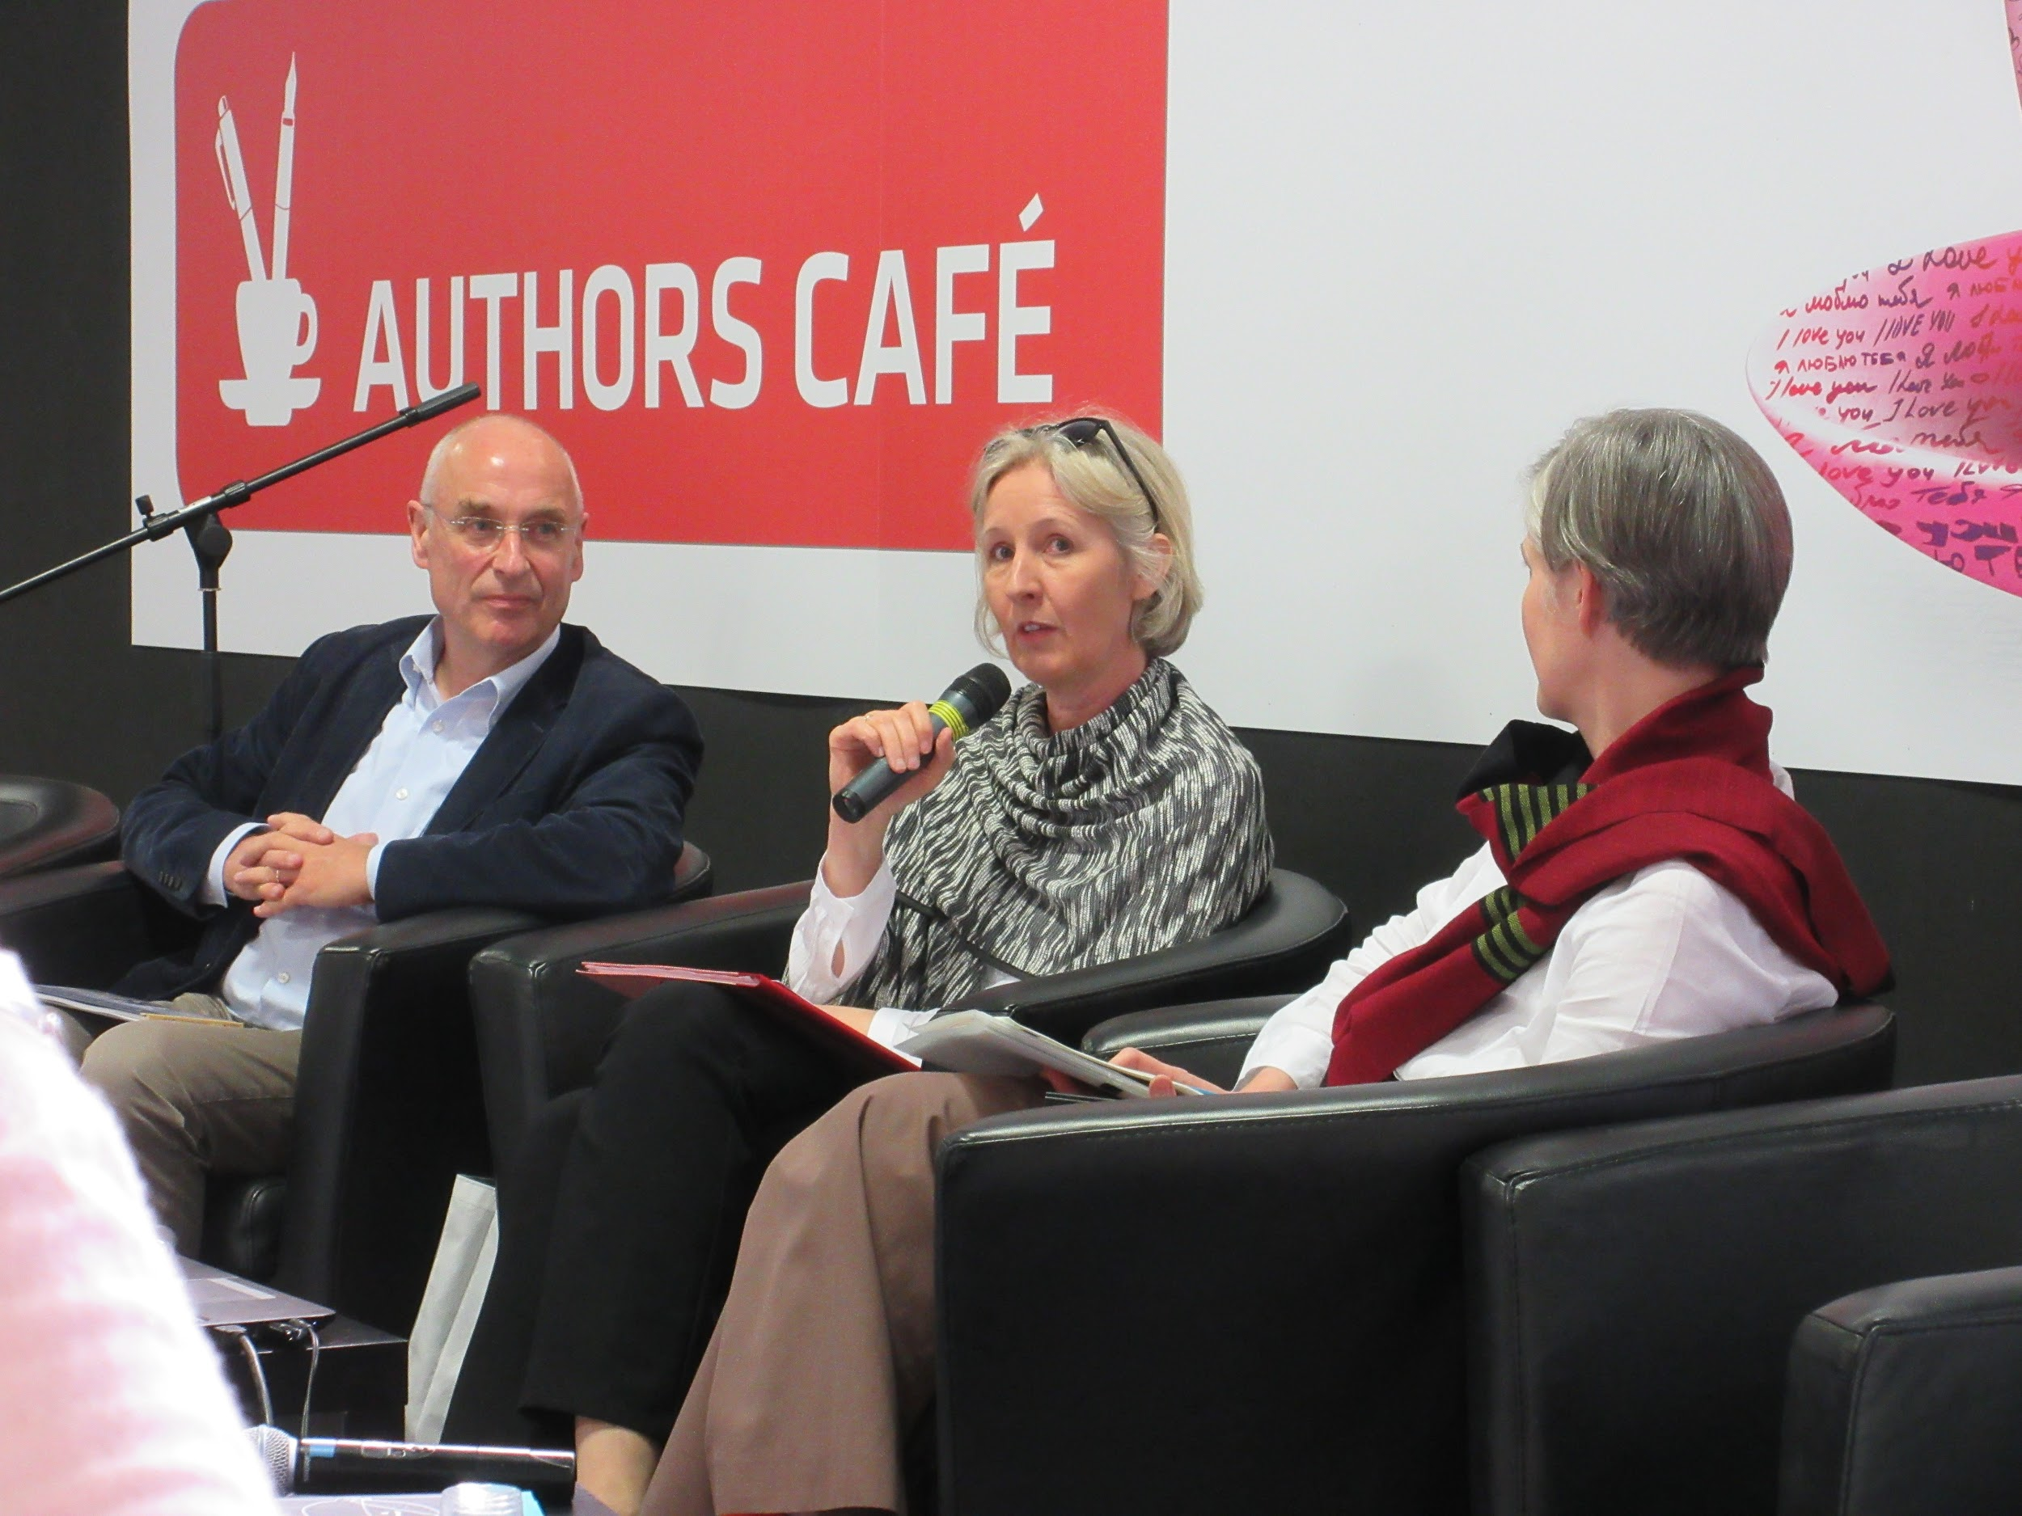

Multilingual Books

Slide 22
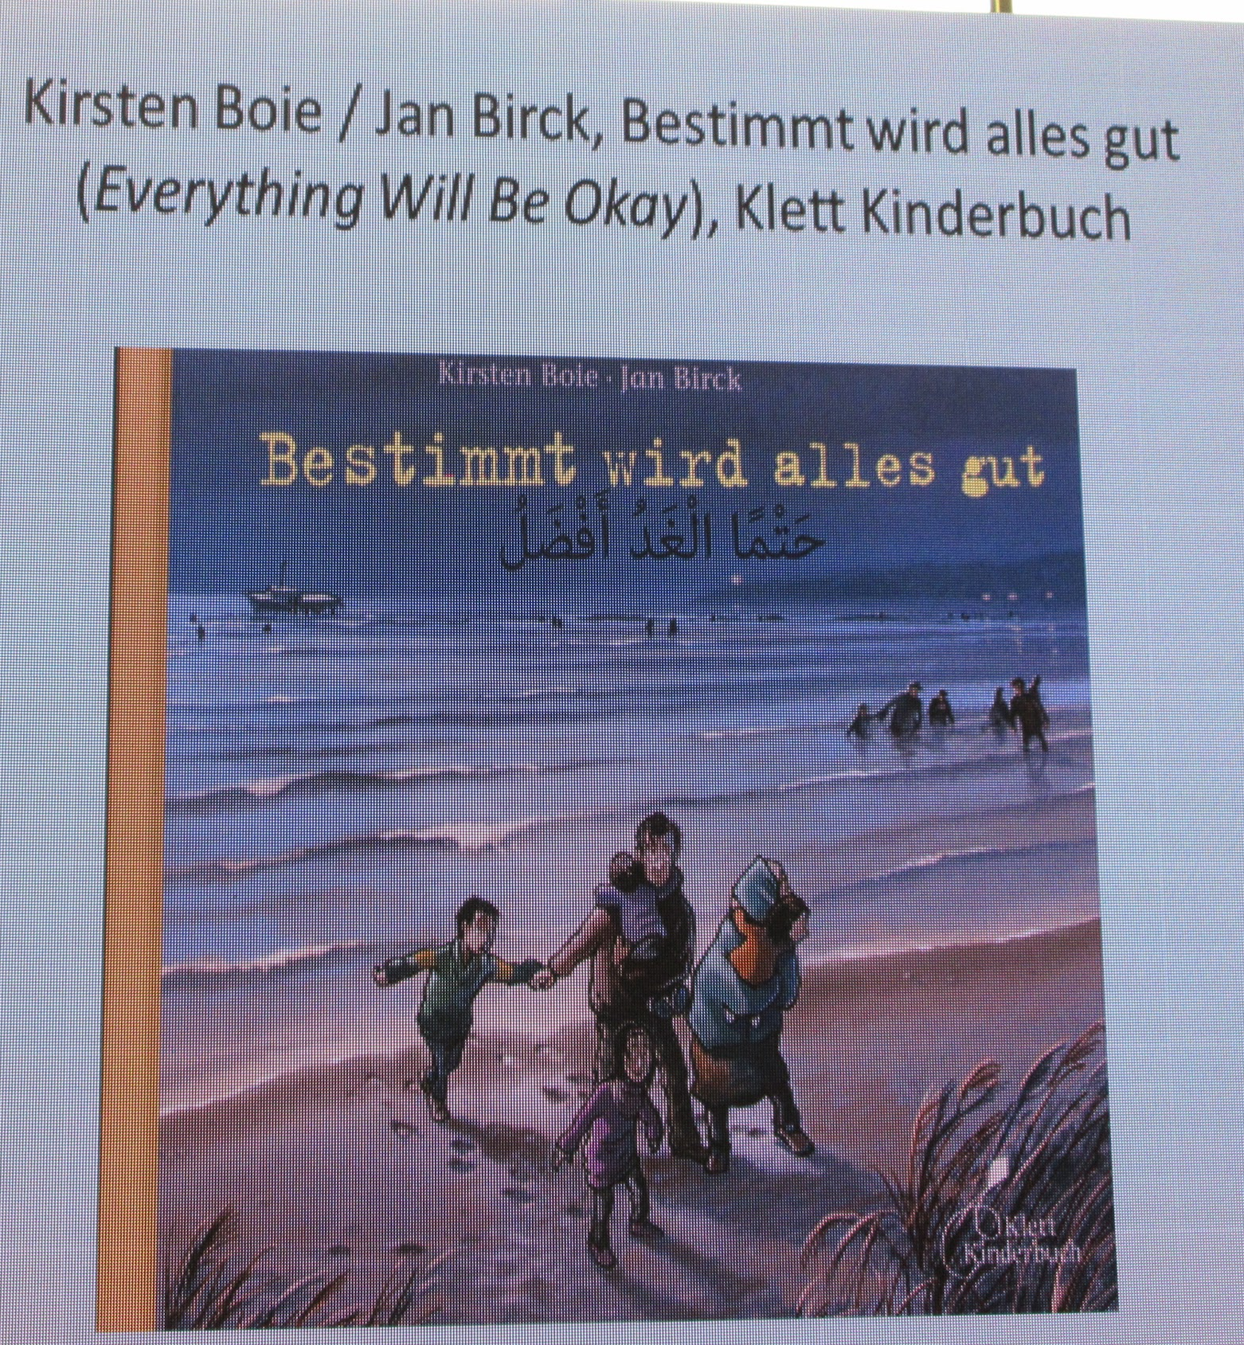
The importance of Keeping the Original Text on the page

Slide 23
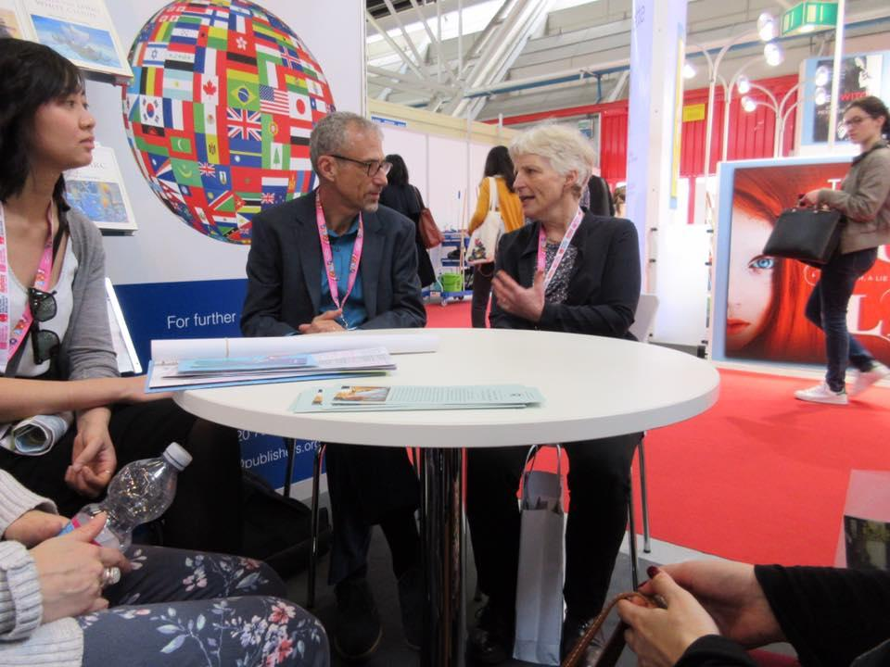
Julia Eccleshare
Add pics
UK Guardian’s Children’s Book Editor

Slide 24
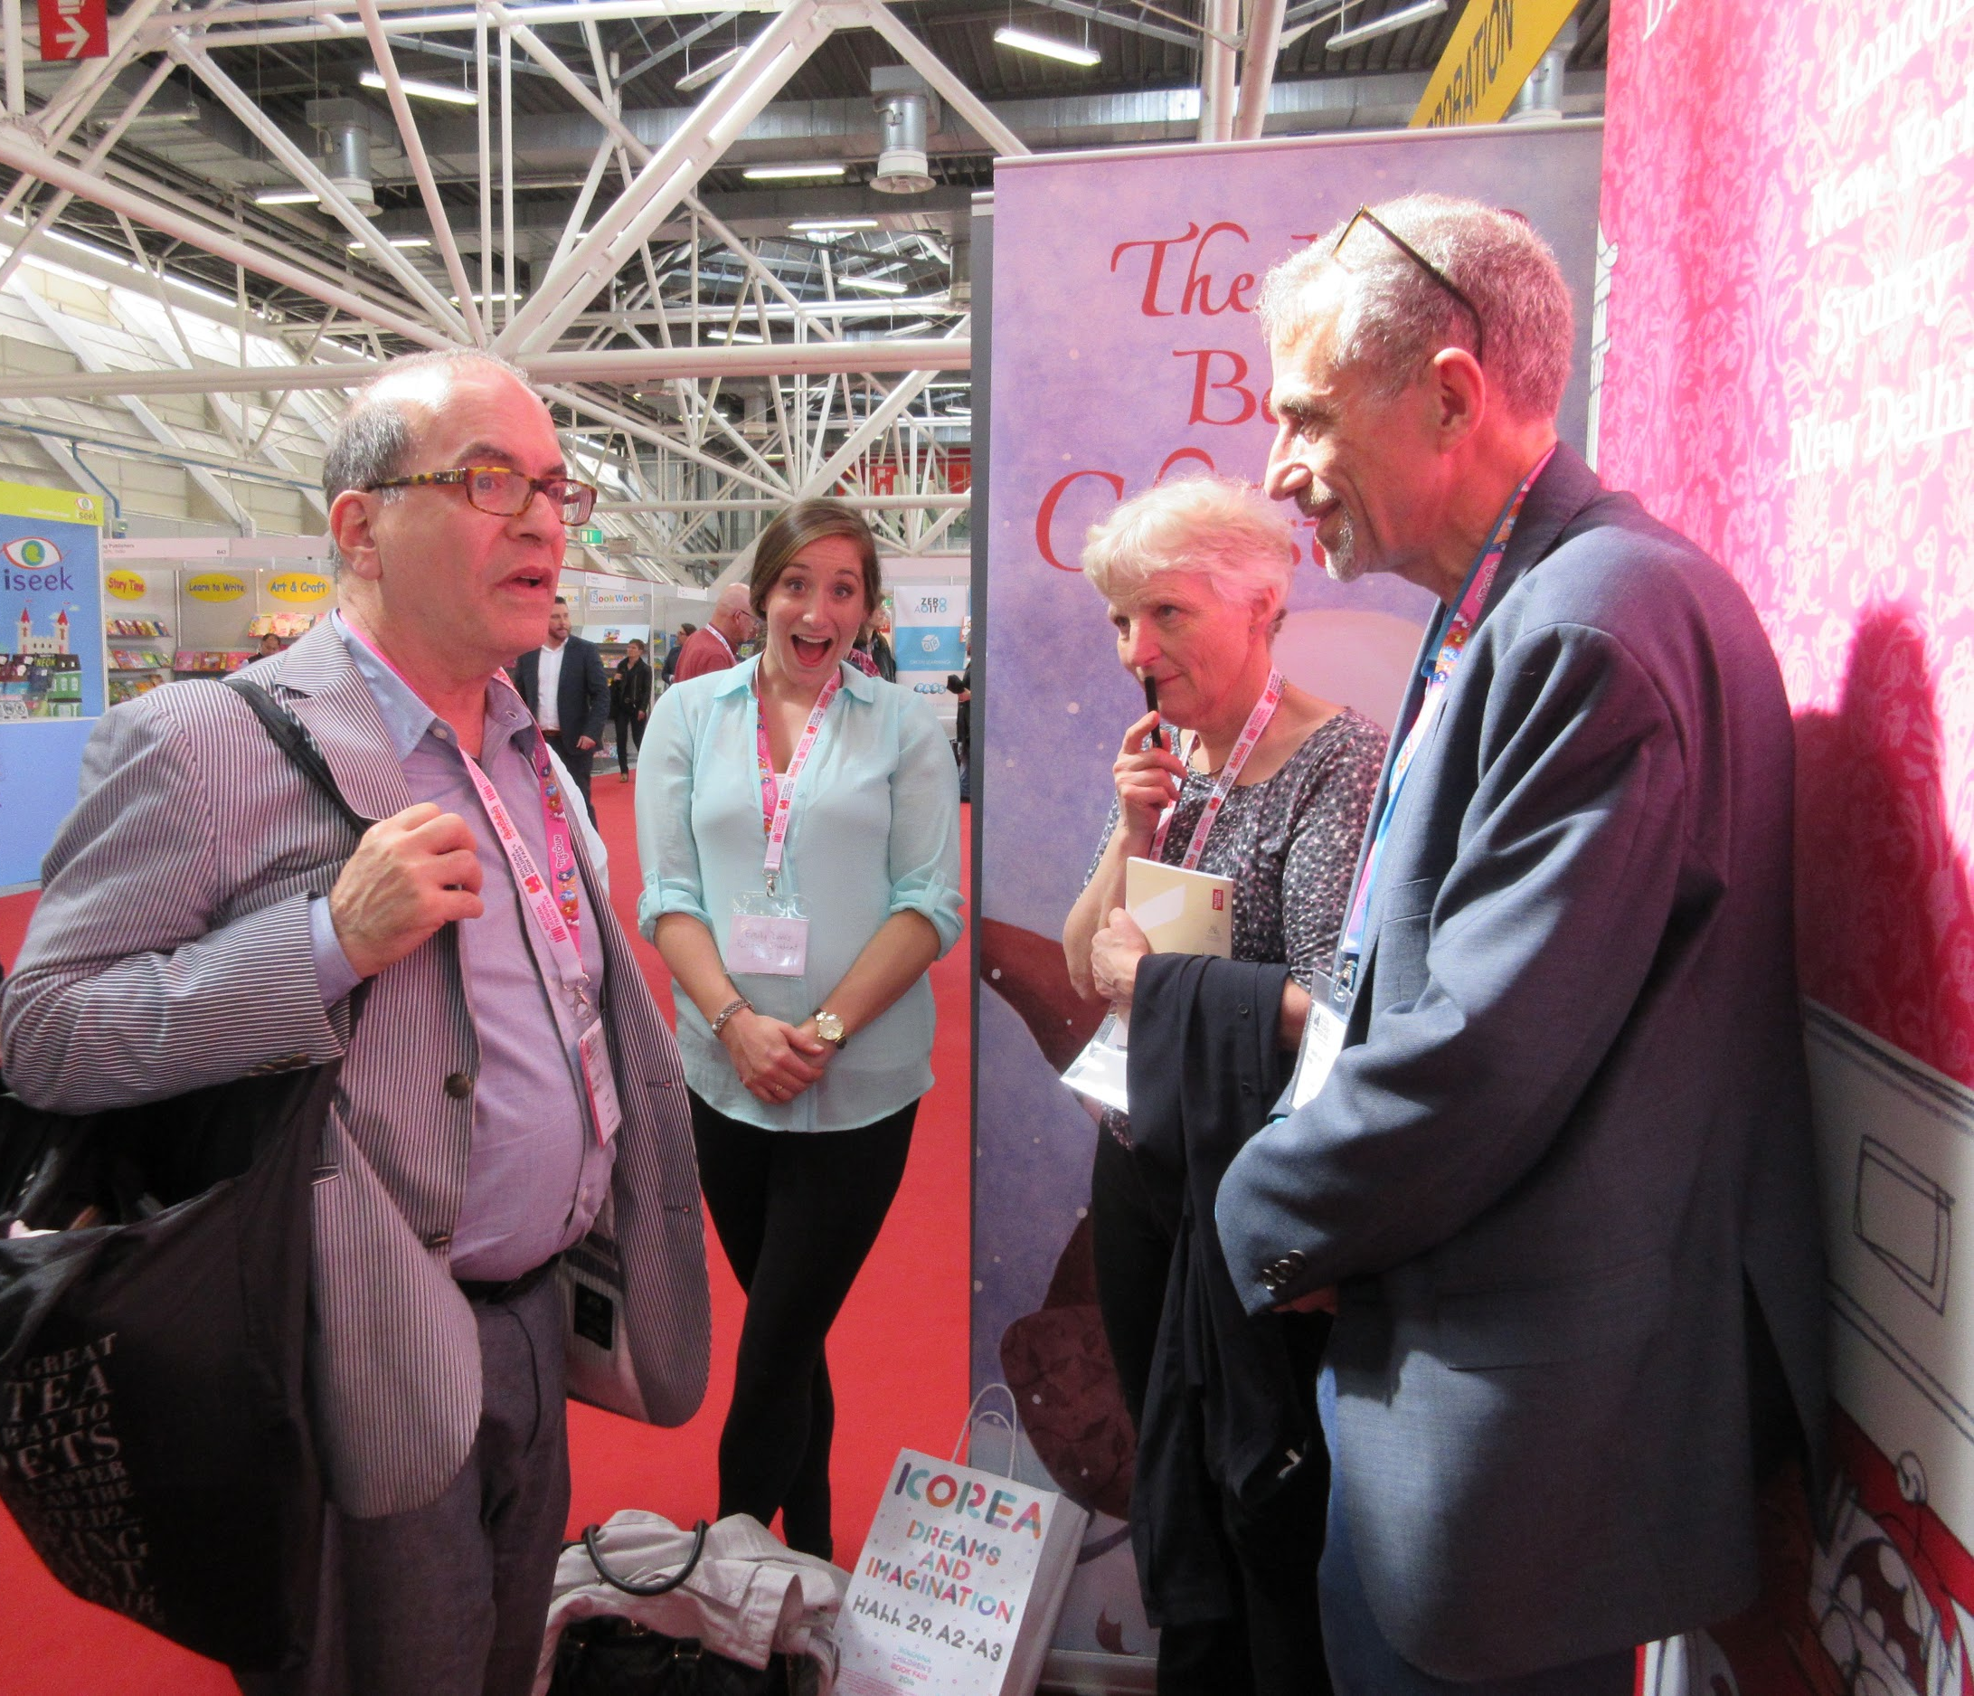
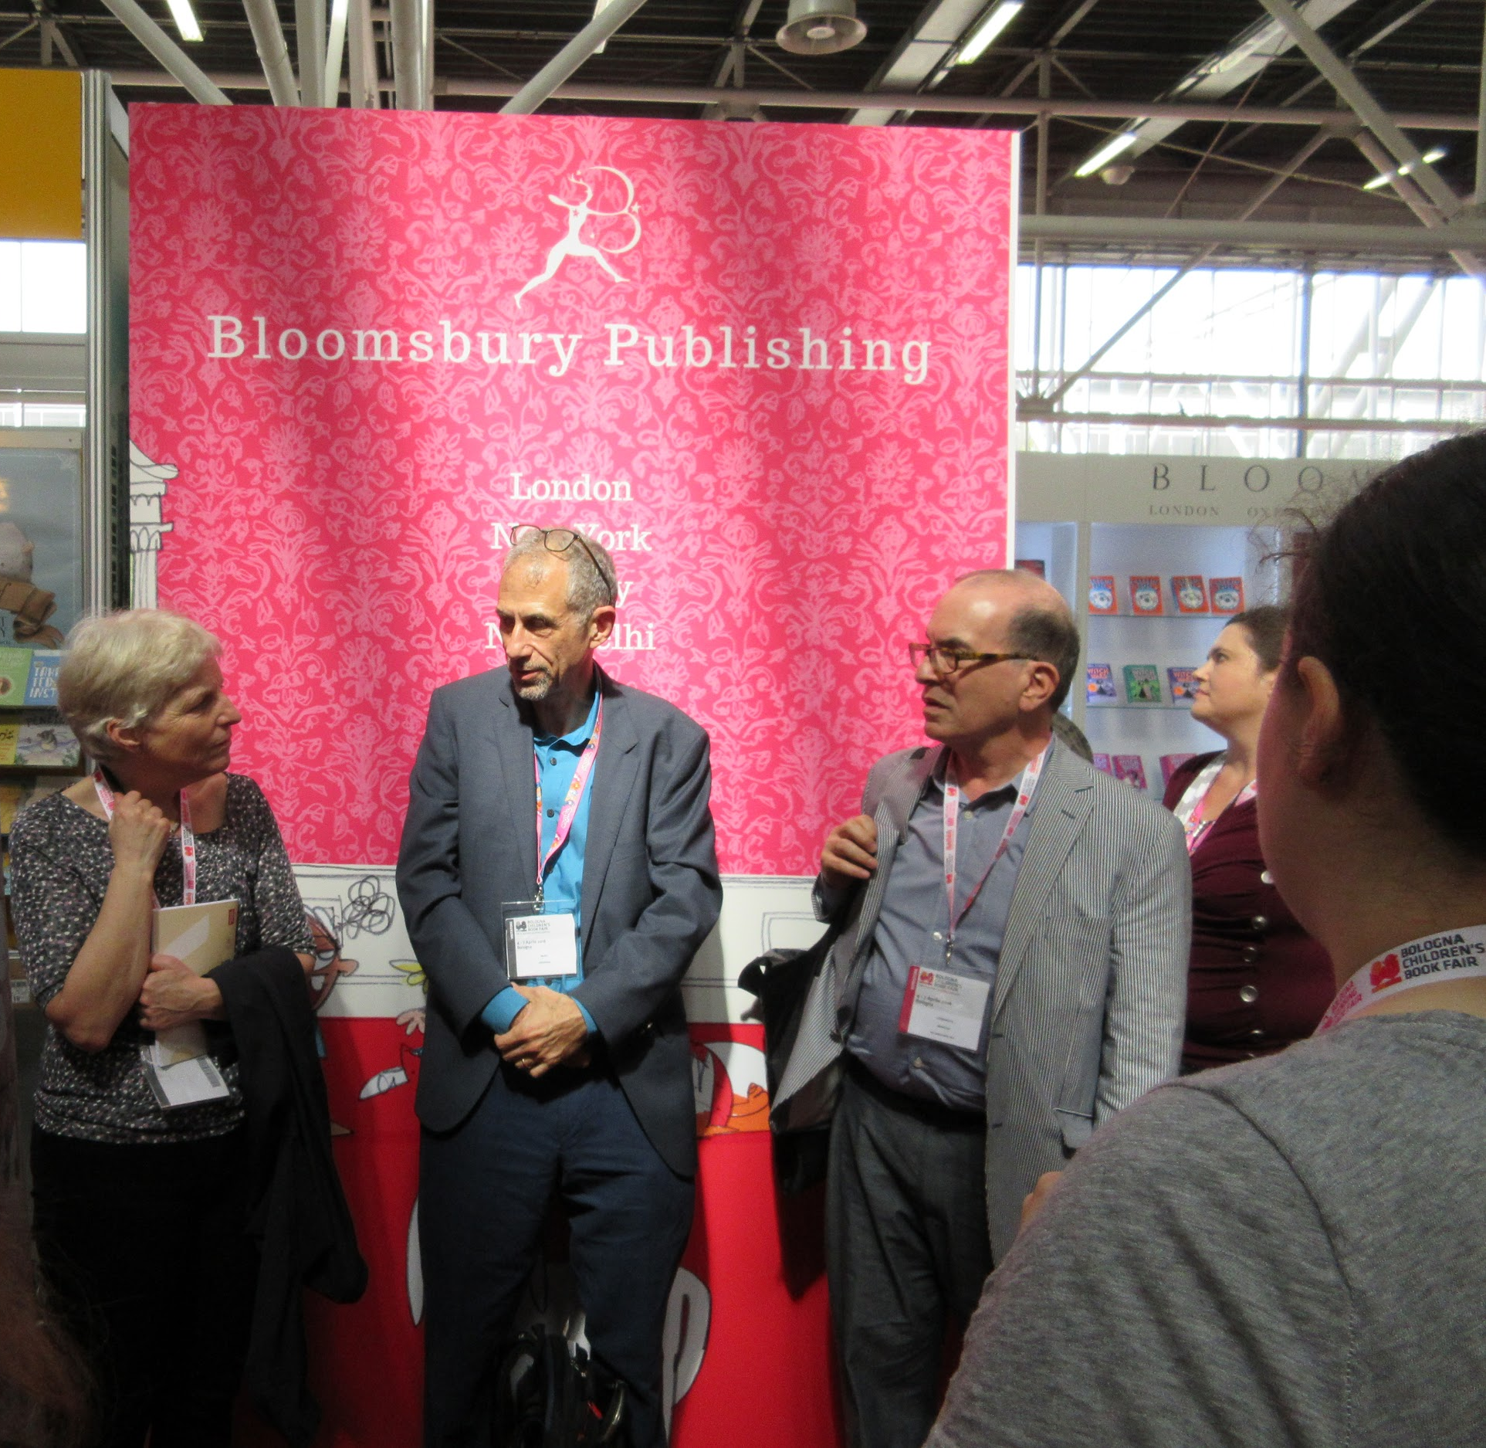
Julia Eccleshare Guardian's children's books editor

Slide 25
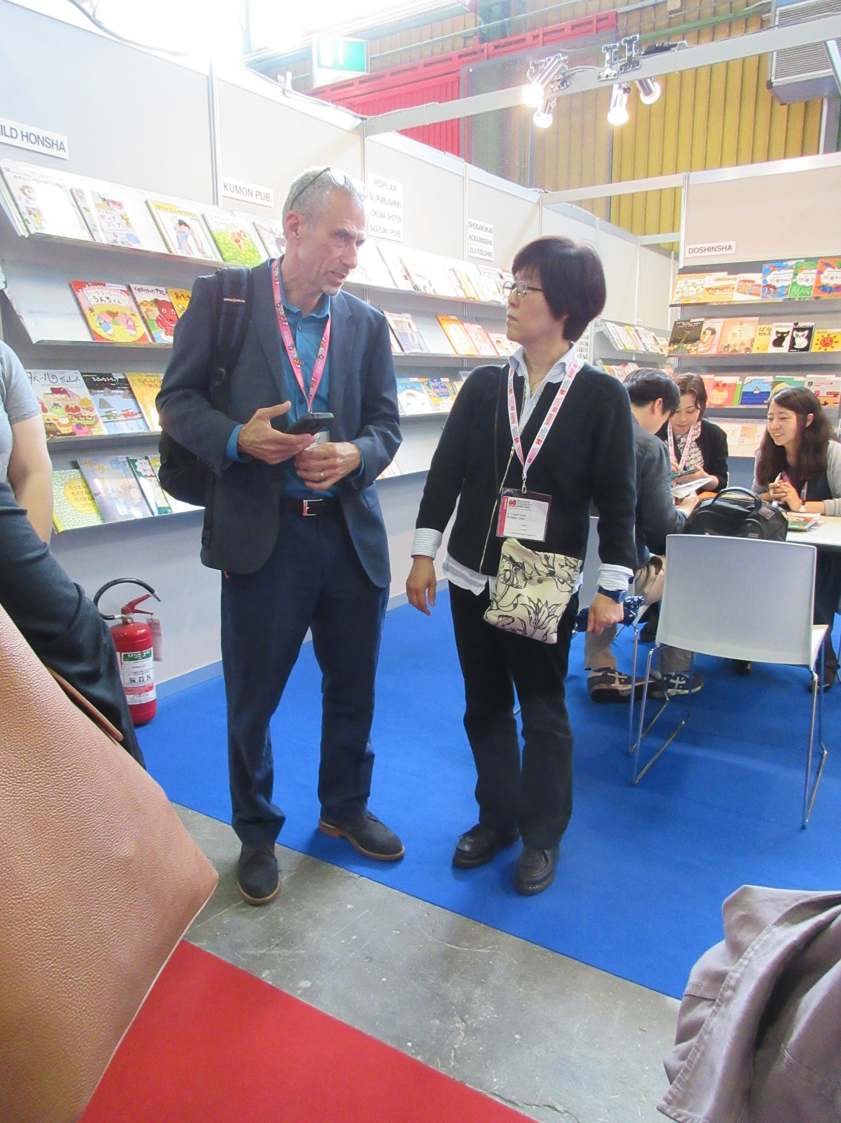
Yurika Yokota Yoshida
Add pics
Japan Foreign-Rights Centre, CEO

Slide 26
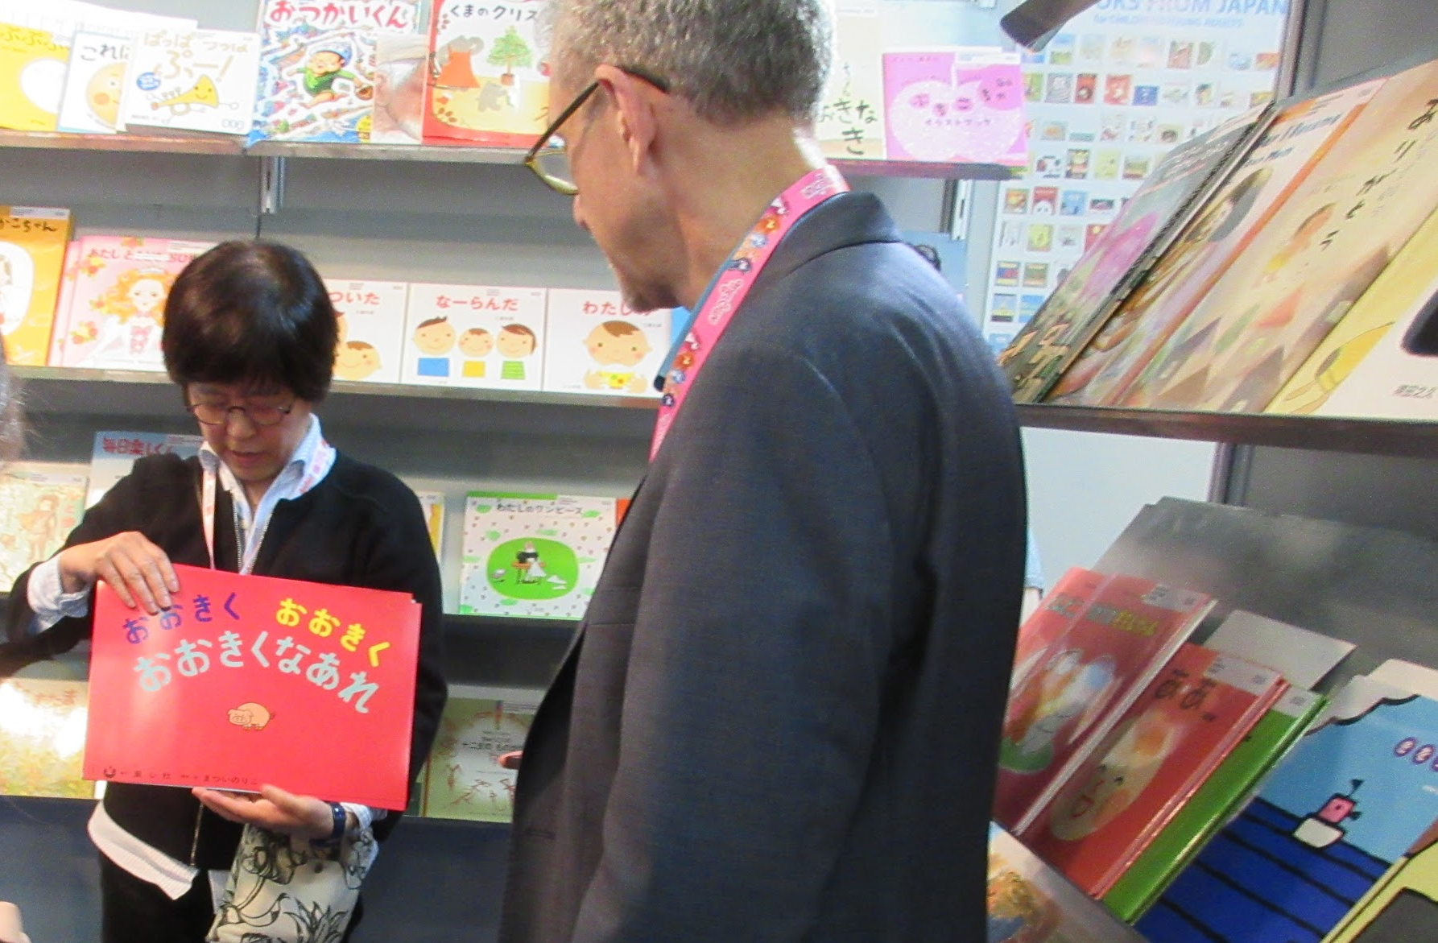
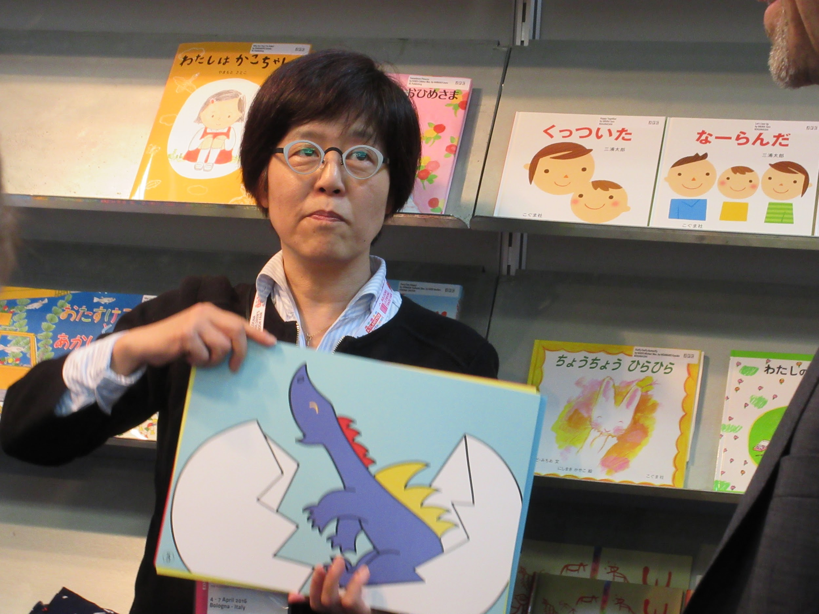
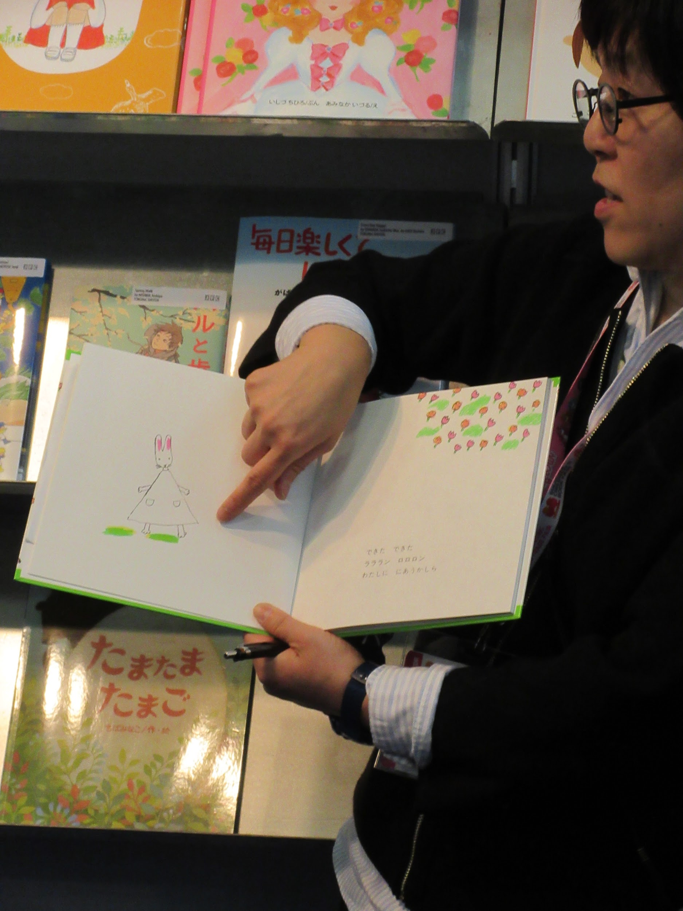
Nothing beats having a story read to you. This was a rare treat from an excellent storyteller.

Slide 27
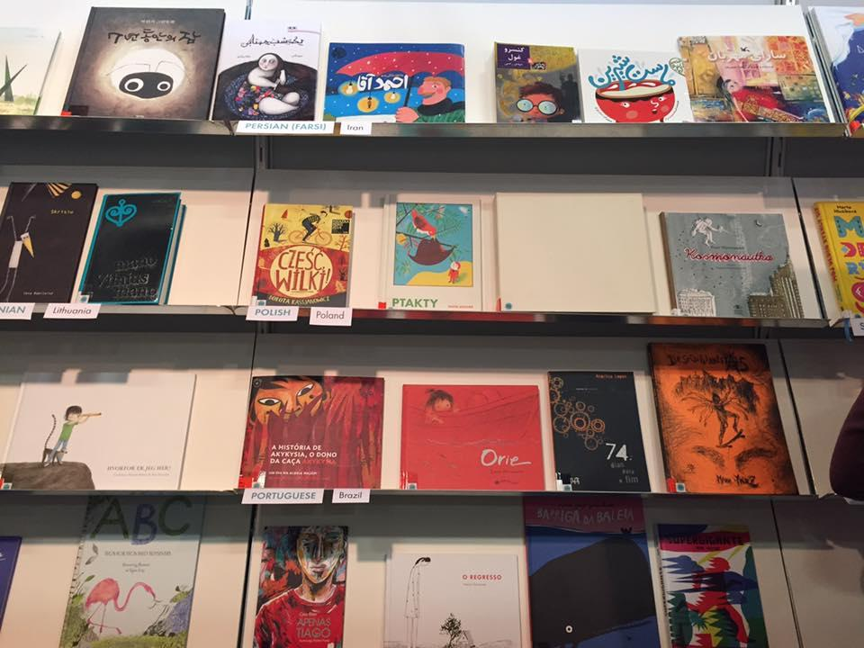
Association for Children's and Youth Literature
IBBY Germany
And
White Raven

Slide 28
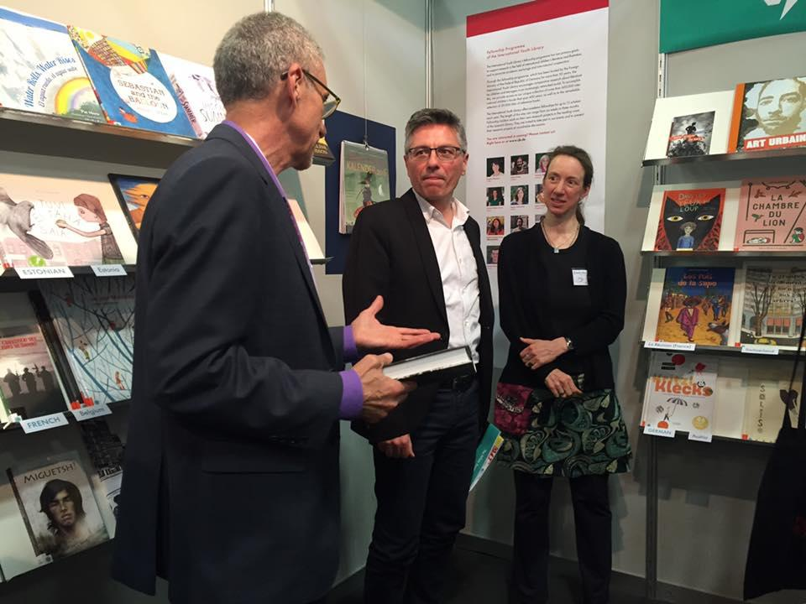
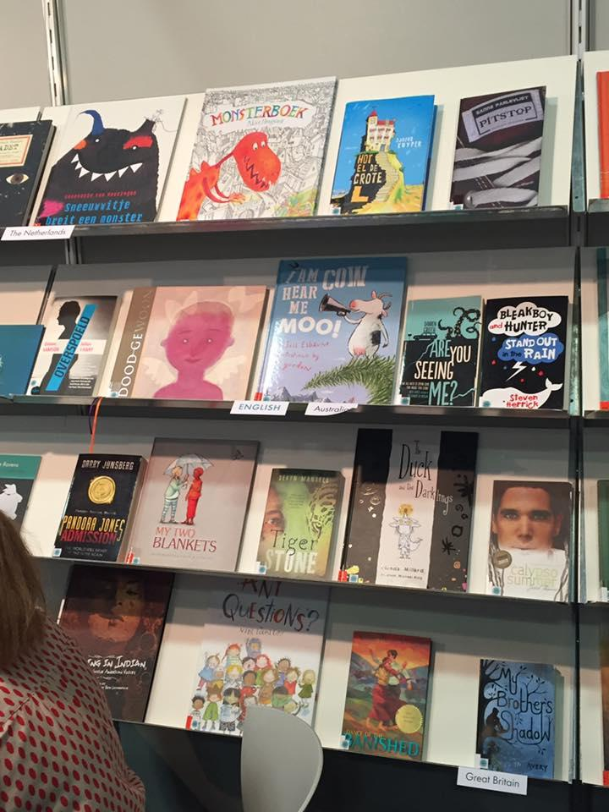
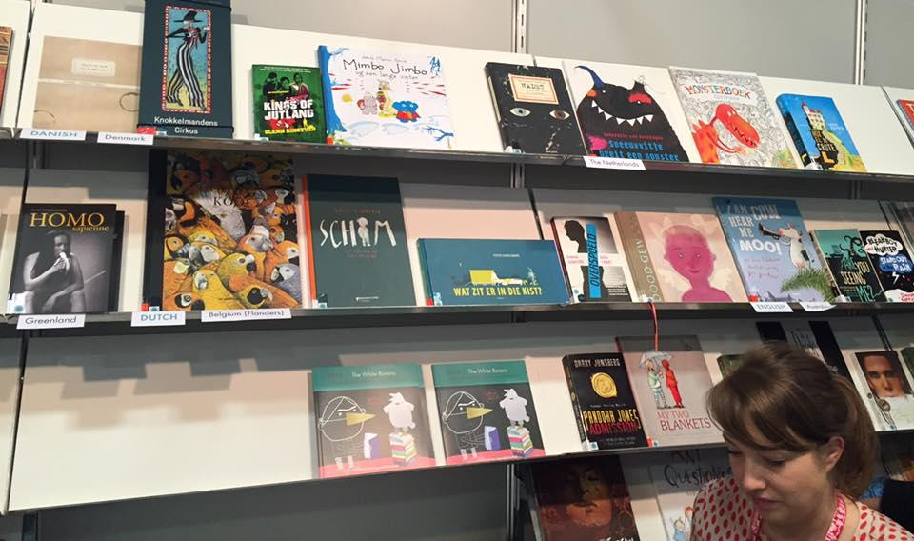
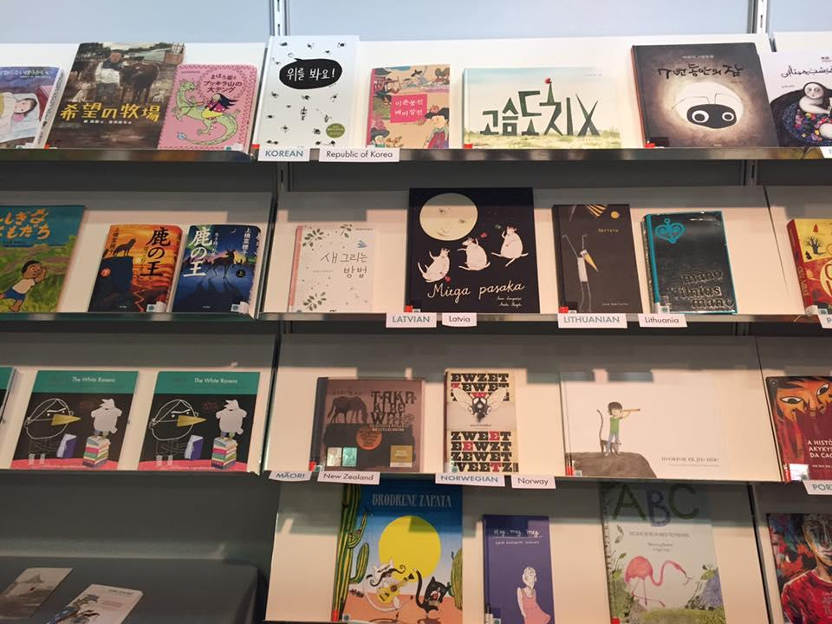

Slide 29
Booths….. So many books…. So many countries…. So little time!

Slide 30
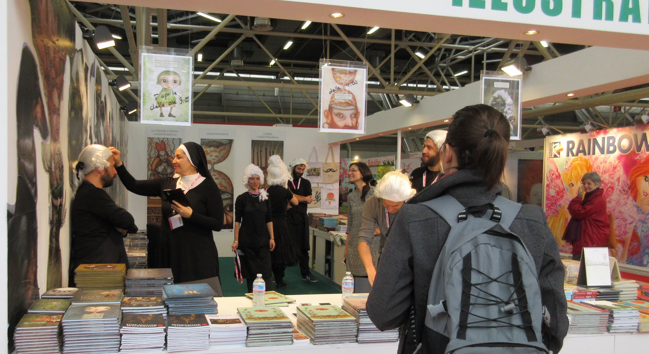
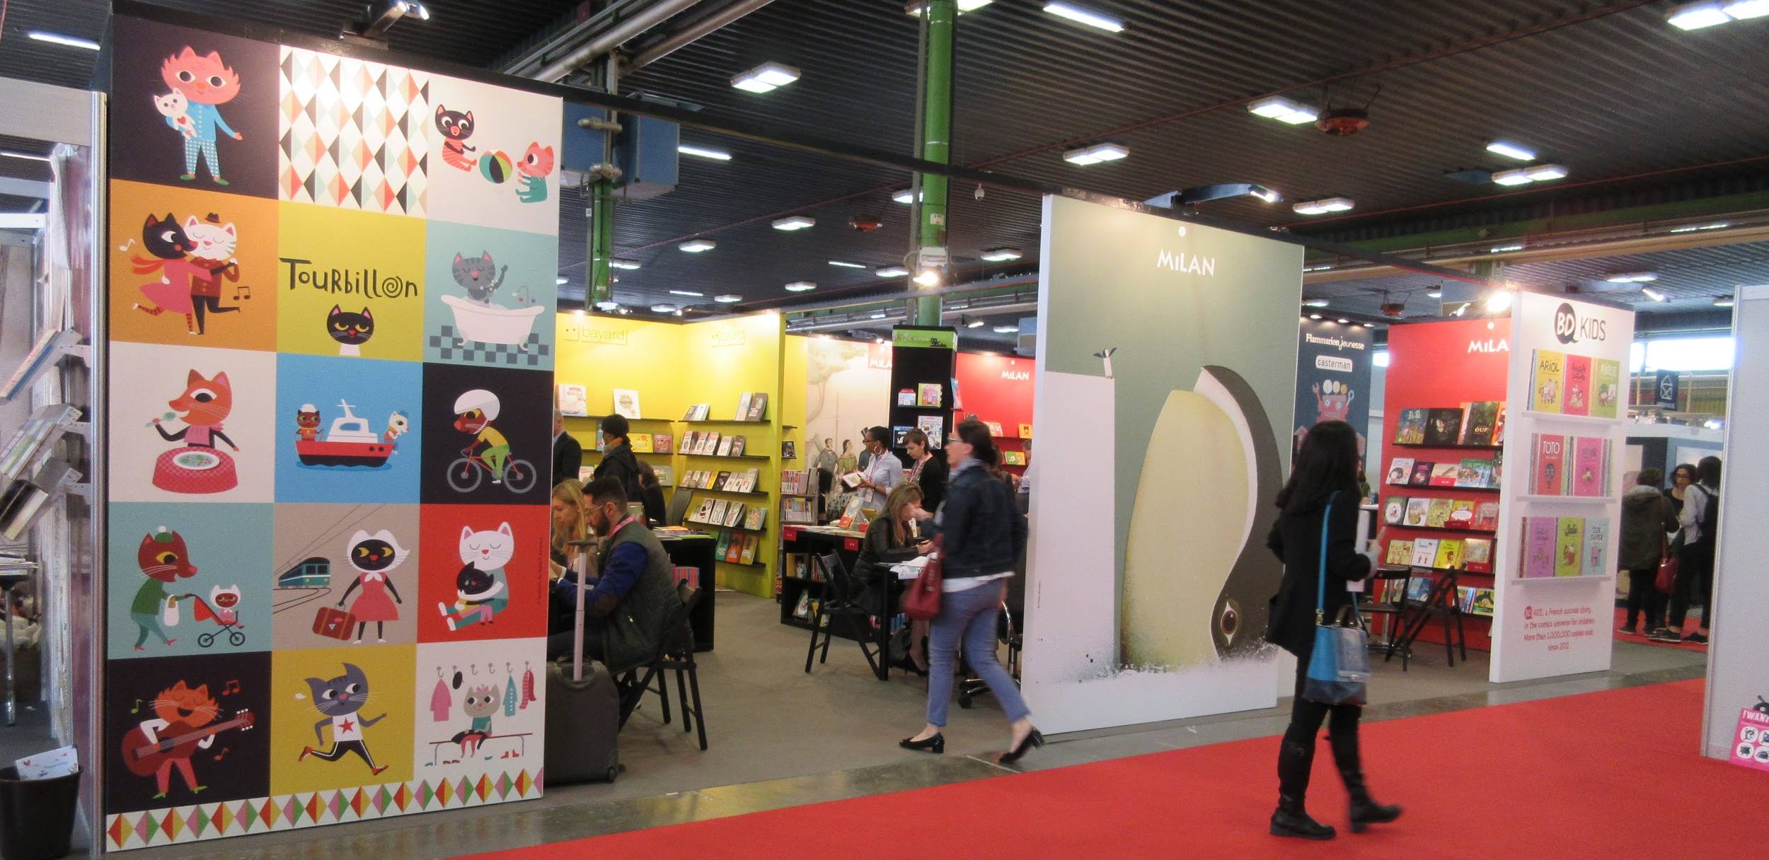


Slide 31
Bologna Book Fair 400%
Worth the trip

Slide 32
American Library in Paris Panel

Slide 33





American Library in Paris

Slide 34




All the libraries you can handle

Slide 35
When in Rome…or actually Bologna, Venice, and Florence… etc
Couldn’t resist sightseeing while abroad.

Slide 36





